Slide 1
Software Engineering
Topic 4:
Software Specification
Your Name: _____________________
Computer Science & Engineering Department
The Chinese University of Hong Kong

Slide 2
Prelude on Specification
A specification is a precise statement of the requirements that a system must satisfy
The term “specification” is used at different stages of software development
  (i) requirement specification
  (ii) design specification
  (iii) module specification
Notes:
In traditional engineering disciplines, the word specification has a precise meaning. In software engineering, the term is used in several contexts with different meanings. We ourselves have used it informally several times in the previous topics.
In general, we can view a specification as a precise statement of the requirements that a system must satisfy. The agreement of the requirements can be established between a producer of a service and a consumer of the service, or between an implementer and a user. Depending on the context, the implementer and the user are different, and the nature of the specification is different.
The term specification is used at different stages of software development.
A requirements specification is an agreement between the end user and the software developer.
A design specification, for example, in terms of the USES hierarchy (see Topic 5 later), a UML class diagram, or a system or modular interface, is an agreement between the system architect (or designer) and the implementers.
A module specification is an agreement between the programmers using the module and the programmer implementing the module. For instance, the exports clause of the modules in a TDN description (see Topic 5 later) can be viewed as a (syntactic) specification of those modules. Similarly, class diagrams can be enriched by listing the signature of all the exported operations.

Slide 3
Specification
A broad term that means __definition__
Generally, a statement of agreement
(_”contract”_) between
  producer vs. consumer of a service, or
  designer/implementer vs. user
All desirable qualities must be specified
We focus on functional specifications in this topic.
Notes:
Specification is a broad term that means definition.
Generally, it is a statement of agreement, or contract, between either a producer vs. a consumer of a service, or the product designer/implementer vs. the user.
Specification is a simple way to describe what one wants is just to give an example of how it can be done. This implies not that it must be done in exactly that way, but that it must behave as if it were done that way.
For instance, one can state that the execution of several concurrent transactions in an information system must be performed as if each transaction were executed in a noninterruptible way. This does not necessarily require the implementer to let each transaction run to completion before starting another one, which would be highly inefficient in the case of long transactions.
In principle, all desirable qualities should be specified, and the implementation should ensure that all desirable qualities are achieved by the product (e.g., in terms of functionality, usability, performance, portability, etc.). In this topic, however, we concentrate mostly on the specification of software functionality (i.e., on functional specifications).

Slide 4
What Is A Specification?
A specification at some level states the requirements for the implementation at a lower level
Specification states _what_ a system should do; implementation is concerned with _how_to do it.
The distinction between “what” and “how” is not sharp.
  a simple way to describe “what” is just to give an example of “how”
e.g., display of time: “hour” + “:” + “minute”
1 ≤ 2_digit ≤ 12 0 ≤ 2_digit ≤ 59
Notes:
A specification at some level states the requirements for the implementation at a lower level.
The specification states what a system should do; the implementation is concerned with how to do it.
The distinction between specification and implementation is often not so sharp. For instance, in some cases, the decision as to whether to distribute a banking system throughout the bank's branches or to keep it centralized in the main branch and use remote terminals at the other branches can be considered a design matter (i.e., a “how” matter). So one can claim that the physical distribution of the system is not a requirement, but an implementation issue. In other cases, the user can explicitly require a distributed architecture, which then automatically becomes part of the system specification. So an implementation that realizes all required functions, but uses a single mainframe, would be rejected as incorrect.
Furthermore, sometimes a simple way to describe what one wants is just to give an example of how it can be done. This implies not that it must be done in exactly that way, but that it must behave as if it were done that way. For instance, one can state that the execution of several concurrent transactions in an information system must be performed as if each transaction were executed in a non-interruptible way. This does not necessarily require the implementer to let each transaction run to completion before starting another one, which would be highly inefficient in the case of long transactions. Rather, the implementer is free to interleave the execution of different transactions, as long as each is perceived by the user to have run without interruption.
For another example, a specification of display of time can be stated as “hour” plus a colon plus “minute”, which “hour” is 2-digit between 1 and 12, and “minute” is 2-digit between 1 and 59. However, this is not enough as we need to worry about leading 0s in hour and in minute. A leading 0 in hour is often omitted, while a leading 0 in minute is not omitted. It will be easier to give examples.
>>>
Such as to show 2 o’clock, 1 minute, among 02:01, 2:01 and 2:1, 2:01 is the right format. This is already a specification by “how”.

Slide 5
Uses of Specification
Statement of ____user____ requirements
  users’ needs are often not clearly understood by the developer
  major failures occur because of misunderstandings between the producer/developer and the consumer/user
  Sometimes, even the user has no clear idea of what exactly the desired product is
  "The hardest single part of building a software system is deciding precisely what to build" (F. Brooks)
Notes:
Specification is a statement of user requirements. The primary purpose of a product is to meet its user's requirements. Unfortunately, users’ needs are often not clearly understood by the developer, and major failures occur because of misunderstandings between the producer/developer and the consumer/user.
If this is the case, a careful analysis., involving frequent interaction with the user, should be devoted to clarifying, and documenting a clear statement of requirements, in order to uncover and avoid possible misunderstandings. Sometimes, at the beginning of a project, even the user has no clear idea of exactly what the desired products.
According to Fredrick Brooks, a pioneer in Software Engineering, the hardest single part of building a software system is deciding precisely what to build. This refers to user requirements.

Slide 6
Uses of Specification (cont.)
Statement of the interface between the _machine_ and the controlled _environment_
  A flawed specification or a misunderstanding between software engineers and the domain experts can have serious undesirable effects.
  It is necessary to describe precisely inputs, outputs, and expected relationships.
Notes:
Specification is a statement of the interface between the machine and the controlled environment. Computers interact with the external environment by receiving inputs (e.g., signals from the sensors of a controlled plant or commands from a user) and providing outputs (e.g., control data to actuators or responses to user commands). A flawed specification or a misunderstanding between software engineers and the experts in the given domain who know all about the phenomena affecting the control function to be implemented by software can have serious undesirable effects.
Both may cause a later redesign and reimplementation of a large part of the application, thus increasing development costs. But more seriously, in the case of a critical system, if these problems are not caught and propagate to the implementation, they may cause disasters from which it is impossible to recover. It is therefore necessary to specify the interface between the machine and the controlled environment by describing precisely inputs, outputs, and expected relationships, including perhaps a specification of time constraints that the controller should satisfy. Software should produce acceptable output, and it should receive proper input.

Slide 7
Uses of Specification (cont.)
♦ Statement of requirements for _implementation_
  design process is a chain of specification (i.e.,
  definition)–implementation–verification steps
    requirements specification refers to definition of
    ____external____ behavior
      • design specification must be verified toward it
    design specification refers to definition of the
    software _architecture_ and _components_
      • code must be verified toward it
Notes:
Specification is a statement of the requirements for the implementation.
Design process is a chain of 3 steps (1) specification (i.e., definition), (2) implementation, and (3) verification.
Requirements specification refers to definition of external behavior, and design specification must be verified toward it.
Design specification refers to definition of the software architecture and components, and code must be verified toward it.
Specifications are used as a reference point while the product is being implemented. In fact, the ultimate goal of the implementation is to build a product that meets the specifications. Thus, the implementer uses the specifications during the design phase to make design decisions and during the verification activity to check that the implementation complies with the specifications.

Slide 8
Uses of Specification (cont.)
A reference point during _maintenance_
  corrective maintenance only changes
  implementation (or design)
  adaptive and perfective maintenance occur
  because of requirements changes
    requirements specification must change
    accordingly
Notes:
Specification is a reference point during product maintenance. Several kinds of maintenance may occur during a product's life cycle. All involve specifications.
In the case of corrective maintenance, usually only the implementation (or design) is changed. Thus, specifications are needed to check whether the new implementation corrects the errors contained in the previous version of the product. An exception could be when the error is in the specification itself, but is not discovered until the product is used. In this case, one must first correct the specification and then modify the implementation accordingly.
In the case of adaptive and perfective maintenance, as they are due to requirements changes, requirements specification must change accordingly.

Slide 9
Specification Qualities
Spec should be clear, unambiguous, and
understandable
  Pictures are better, if possible (e.g., Galileo diagram)
  Informal spec, written in natural languages (English), are likely to hide subtle ambiguities
  Two examples
    (i) “select” in Microsoft Word
    (ii) message triplication
Notes:
We discuss the qualities that are especially relevant to specifications. The first set of qualities required of specifications is that they should be clear, unambiguous, and understandable. This claim sounds obvious, but it cannot be overemphasized. In particular, informal specifications, written in a natural language, are likely to contain subtle ambiguities.
Two examples are given in the following slides to illustration the criticality and subtlety of specification.

Slide 10
Spec Examples
not sure if possible or not from the spec
(i) A select command in a word processor
  Selecting is the process for designating areas
  of your document that you want to work on.
  Most editing and formatting actions require
  two steps: first you select what you want to
  work on, such as text or graphics; then you
  initiate the appropriate action.
_scattered_
“a contiguous
Sequence of
_characters_
Notes:
This slide gives a sample definition of a “select” command in a word processor. Such a definition does not specify exactly what the term "area" means. It turns out that in most tools the definition implicitly assumes an area to be a contiguous sequence of characters.
A user unaware of this assumption might, however, interpret the term "area" as the collection of scattered sequences of characters, so that one could go through a text, selecting different, not necessarily contiguous, words and then, say, italicizing all of them with a single command. This is not possible in traditional word processors. The main point, however, is that the original specification does not make clear whether it is possible or not.

Slide 11
Spec Examples
(ii) A mission-critical project
  The message must be triplicated. The three copies must be forwarded through three different physical channels. The receiver accepts the message on the basis of a two-out-of-three voting policy.
When? As soon as two identical messages are received or has to wait for 3 messages?
Notes:
This slide gives another specification of a mission-critical project. Intuitively, this specification states that, for reasons of reliability, messages are triplicated. Upon receiving three copies of a message, the receiver determines the content by comparing the copies: If two of them match, their content is assumed correct.
It is not clear, however, whether the message may, or should, be considered received as soon as two identical copies have been received, without waiting for the third one, or whether the receiver should wait for all three copies before comparing their contents. Since we are talking about a real-time system, this point can make a significant difference when it comes to acting on the message.

Slide 12
Specification Qualities
(2) Spec should be ____consistent____
  An example: word processing for “text”
    English spec:
    The whole text should be kept in lines of equal length, with the length specified by the user.
    Unless the user gives an explicit hyphenation command, a carriage return should occur only at the end of a word.
Notes:
The second quality requirement of specifications is that they should be consistent. That is, they should not be self-contradictory in any circumstances.
The specification on word processing for “text” is given as an example here. This definition, however, does not cover the case where a particular word is longer than the length specified for lines. In such a case, the specification is self-contradictory, or inconsistent.
Therefore, no implementation can satisfy it. The probability of inadvertently including some inconsistency in a specification increases as the specification documents become longer and more complex, which is often the case in real-life projects.

Slide 13
Specification Qualities
(3) Spec should be _____complete_____
  internally complete (self-contained)
    define all new concept or terminology it uses
    glossary helpful for this purpose
  externally complete: complete with respect to user requirements
    specify all the functional requirements
    be wary of non-functional requirements (e.g., performance, exceptional cases)
    difficulty: when should one stop?
Due to the difficulties in achieving complete spec, the use of
the __incrementality__ principle is especially important
Notes:
The third quality requirement for specifications is that they should be complete. There are two aspects of completeness. First, the specification must be internally complete. This means that the specification must define any new concept or terminology that it uses. A glossary is often helpful for this purpose.
For example, if the specification of an elevator system states that "in the absence of any outstanding requests, the elevator enters a wait-for-request state," the specification must also define the meaning of "wait-for-request state.“
Specifications also should be externally complete, that is, complete with respect to user requirements. This means specifications should specify all functional requirements, and be wary of non-functional requirements such acceptable performance and possible exceptional cases.
One might even argue that in many practical cases, including the examples we have discussed so far, specifications are stated informally on purpose, because the choice of which interpretation should be given to remove ambiguities is viewed as an implementation decision.
The difficulty here is “when should one stop in further specification details?” Too little detail leads to incomplete specification. Too much detail may constrain the design.
Due to the difficulties in achieving complete spec, the use of the incrementality principle is especially important .

Slide 14
Specification Qualities
Spec should be ___incremental___
  Referring to the specification process
    start from a sketchy document and progressively add details
  Referring to the specification document
    document is structured and can be understood in increments
Notes:
Thus the fourth quality requirement of specifications is they should be incremental. We provide the reasons as follows.
One or another way of removing these ambiguities is equally acceptable from the user's standpoint. According to this view, providing a precise specification would over specify the system and unduly constrain the implementer. The weakness in this position is that one does not ordinarily know whether the lack of precision in the specification is deliberate or due to oversight.
Moreover, the use of an informal language does not help in highlighting the places where ambiguities are hidden. Only when one tries to describe the requirements formally do the questions arise. At that point, one can make a conscious and explicit decision: Either the specification should precisely state what is to be done, or the resolution of the ambiguity should be deferred to the implementation.
Because of the difficulties in achieving complete, precise, and unambiguous specifications, the use of the incrementality principle is especially important in deriving specifications: That is, one may start off with a fairly sketchy specification document and expand it through several steps, perhaps after some experience with early prototypes; We shall see examples of this strategy later in the topic. For similar reasons, the modularity principle is also important for specifications.

Slide 15
Classification of Specification Styles
(1) Formal vs. Informal spec
  informal - natural language (structured or non-structured)
    e.g., given earlier in this lecture
  formal - a fully precise syntax and semantics
  ➔__mathematical__
  semi-formal - notation without a completely precise semantics
Notes:
Specifications can be stated formally or informally. Informal specifications are written in a natural language; they can, however, also make use of figures, tables, and other notations to provide more structure and help the understanding. They can also be structured in a standardized way.
A notation that has a precise syntax and meaning is called a formalism. We use formalisms to create formal specifications. It is also useful to talk of semiformal specifications, since, in practice, we sometimes use a notation without insisting on a completely precise semantics for it. The TDN and GDN notations (in Topic 5) are an example of semiformal notations, since they put together a formal syntactic description of module interfaces and an informal statement of their meaning. We shall see later how the informal comments in our TDN module specifications can be made precise by formalizing the semantics of the operations.
Similarly, UML class diagrams can be used as a semiformal notation to describe a design. A formal language called Object Constraint Language (OCL) is also available to provide precise semantics of classes.

Slide 16
Classification of Specification Styles
(2) Operational vs. Descriptive spec
  Operational - describe the intended system by defining the desired behavior, usually through a model of the system
  Descriptive - state the desired-properties of the system in a purely declarative fashion
  examples of spec about ellipse
    Question: How do you specify an ellipse?
    Operational/descriptive specs: next slide
  examples of spec about sorting an array
    Question: How do you specify a sorting function?
    Operational/descriptive specs: after next slide
Notes:
The second major distinction between different specification styles is between operational and descriptive specifications.
Operational specifications describe the intended system by describing its desired behavior, usually by providing a model implementation of the system (i.e., an abstract device that in some way can simulate its behavior). By contrast, descriptive specifications try to state the desired properties of the system in a purely declarative fashion.
Examples are given in the next two slides.

Slide 17
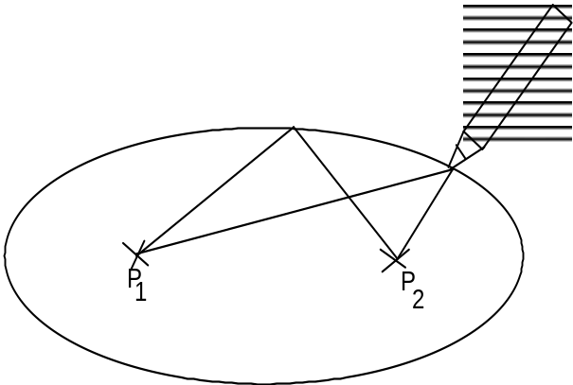
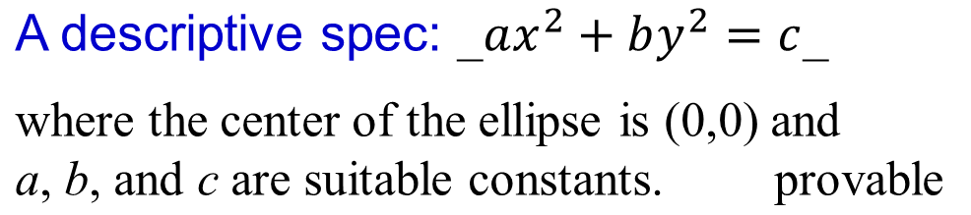
Spec Style Examples
• A spec for defining an ellipse
An operational spec:
  E is the path of the point that moves so that the sum of
  its distances from two fixed points P₁ and P₂ is
  _constant_, and _larger than P1P2__.
  Property of operational spec:
  __testable__
a
b
ap₁ + ap₂ = bp₁ + bp₂
(x, y)
y
(0,0) is center
of the ellipse
x
Notes:
The example shows that an operational definition readily allows us to check whether the specification describes the kind of curve (such as an ellipse) that we had in mind when we gave the specification.
It is in fact easy to draw a curve with paper and pencil following the specification and then examine whether the curve satisfies, say, the aesthetic requirements we had in mind. This slide gives an operational specification for ellipse first. Of course, the implementation of the curve might turn out to be entirely different from what is given in the specification; for example, it might be a curve to be displayed on a graphics terminal. Nevertheless, experimentation helps us understand whether the specification we gave is correct.
By contrast, we can provide a description specification by giving a equation. If we want to check whether, say, a given point P at position (x, y) lies on the curve (e.g., an ellipse), we can do that more easily by referring to the equation for the ellipse, which might also help in assessing the adequacy of the requirements. The curve might be the trajectory of a robot, point P might represent the site where a human should work, and safety reasons might require that the robot never cross point P.

Slide 18
Spec Style Examples
A spec for sorting an array
  Operational spec:
    Let a be an array of n elements. The result of sorting a is an array b
    of n elements such that the first elements of b is the minimum of a
    (if several elements of a have the same value, any one of them is
    acceptable), the second element of b is the minimum of the array of
    n-1 elements obtained from a by removing its minimum element;
    and so on until all n elements of a have been removed.
    Feature: __implies preference in algorithm (e.g. bubble/selection sort)__
  Descriptive spec:
    The result of sorting a is an array b which is a permutation of a and
    is sorted.
    does not imply preference in algorithm, so quicker
    Feature: _sorting algorithm can be encouraged___________
Notes:
This specification suggests a natural and simple (although not very efficient) way of implementing the sorting of an array. The suggestion, however, does not imply that, a sorting algorithm must sort a in that way: It must only produce the same result. Thus quicksort, for example, is a perfectly adequate implementation of the specification. The problem with this kind of specification, however, is that it is difficult for the reader to determine what it actually prescribes, what must be implemented, and what is not.

Slide 19
Classification of Specification Styles
(2) Operational vs. Descriptive spec
  Descriptive specs tend to be more abstract than operation specs because they do not bias the reader towards any particular implementation
  The distinction between operational and descriptive specs is not sharp
  Operational spec:
    DFD: Data Flow Diagrams
    ⇒ FSM: Finite State Machine
    ⇒ PN: Petri Net
  Descriptive spec: ⇒ Logic Specification
Notes:
No style or notation, however, formal or informal, can guarantee that the designer will come up with a good design or an insightful formulation of a problem. Good specification and design require adequate skills, experience, taste, judgment, and even creativity: Since so much in the design activity depends on subjective criteria, it is important to develop a critical intuition that enables one to adapt the right specification style, technique, and notation to the problem at hand.
Descriptive specs tend to be more abstract than operation specs because they do not bias the reader towards any particular implementation; however, the distinction between operational and descriptive specs is not sharp.

Slide 20
Classification of Specification Styles
(3) Data paradigm vs. Process paradigm
  data paradigm - the spec advocates the
  primacy of data abstractions
    ⇒ DFD: Data Flow Diagrams
  process paradigm - the spec focuses on
  sequences of events or actions
  (operations)
    ⇒ FSM: Finite State Machine
    ⇒ PN: Petri Net
Notes:
Another way to classify specifications is that there are data paradigm and process paradigm.
In the data paradigm, the specification advocates the primacy of data abstraction; while in the process paradigm, the specification focuses on sequences of events or actions (operations).
Good specification and design require adequate skills, experience, taste, judgment, and even creativity: Since so much in the design activity depends on subjective criteria, it is important to develop a critical intuition that enables one to adapt the right specification style, technique, and notation to the problem at hand.

Slide 21
Verification of Specs
specs must be verified prior to design and implementation
two general techniques:
  (1) observe the dynamic behavior of the specified system to check its correctness (____operational___ spec)
  (2) analyze the properties of the specified system that can be deduced from the spec (___descriptive___ spec)
effectiveness of both techniques increases when formality of spec increases.
Technique (1) could be done via simulation, yielding prototype of the specified system
Technique (2) could be done by human inspection or theorem proving
Verifying spec correctness, consistency and completeness is formidable and tedious task. It is easier for formal spec to be verified automatically and reliably.
Notes:
There are two general ways of verifying a specification. One consists of observing the dynamic behavior of the specified system in order to check whether it conforms to the intuitive understanding we had of the behavior of the ideal system. The other consists of analyzing the properties of the specified system that can be deduced from the specification. The properties that are deduced are then checked against the expected properties of the system.
The effectiveness of both techniques increases as a function of the degree of formality of the specification. In fact, in a completely formal setting, a way of observing the dynamic behavior of the specified system may consist of providing an interpreter of the formal language in which the specifications are written and then executing formal specifications on sample input data. Similarly, deducing new properties from the ones stated as part of the (descriptive) specification can be made mechanical in some formal logic setting.

Slide 22
Operational Specifications
(A) Data Flow Diagrams (DFD)
(B) Finite State Machines (FSM)
(C) Petri Nets (PN)
Notes:
We will introduce three operational specifications in the class, including Data Flow Diagram (DFD), Finite State Machines (FSM), and Petri Nets (PN).

Slide 23
(A) Data Flow Diagrams
They describe systems as collections of data that are manipulated by functions.
  Basic elements
or
output device
functions
data flow
input device
data store
Notes:
Data flow diagrams (DFDs) are a well-known and widely used notation for specifying the functions of an information system and how data flow from functions to functions.
DFDs describe systems as collections of functions that manipulate data. Data can be organized in several ways: They can be stored in data repositories, they can flow in data flows, and they can be transferred to or from the external environment.

Slide 24
(A) Data Flow Diagrams
An example: DFD for (a+b) * (c+a*d)
  Figure 4.1
A DFD construction method
Two more examples
  Figure 4.2: A simplified information system for a public library (a first approximation of the system)
  Figure 4.3: A finer description (partial refinement)
Notes:
This slide shows an example. Detailed explanations are in the following slides.

Slide 25
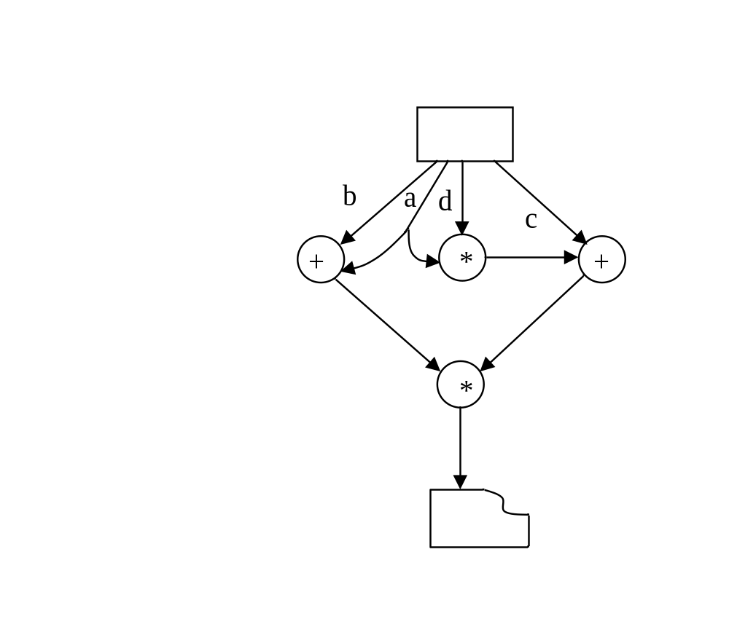
(A) Data Flow Diagrams: A Simple Example
Figure 4.1 A DFD which
specifies evaluation of
(a + b) * (c + a * d)
Notes:
Figure 4.1 shows how the symbols can be composed to form a DFD.
The DFD describes the evaluation of the arithmetic expression assuming that the data a, b, c, and d are read from a terminal and the result is printed. The figure shows that arrows can be "forked" to represent the fact that the same datum is used in different places.

Slide 26
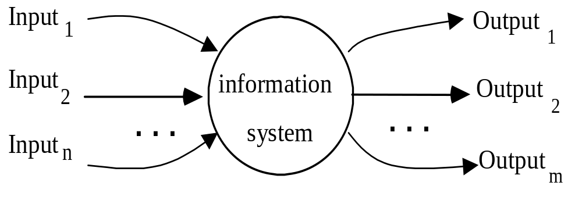
A Construction “Method” (1)
1. Start from the “context” diagram
Notes:
We introduce one construction method to handle a complex DFD. It starts from the context of both inputs and outputs.

Slide 27
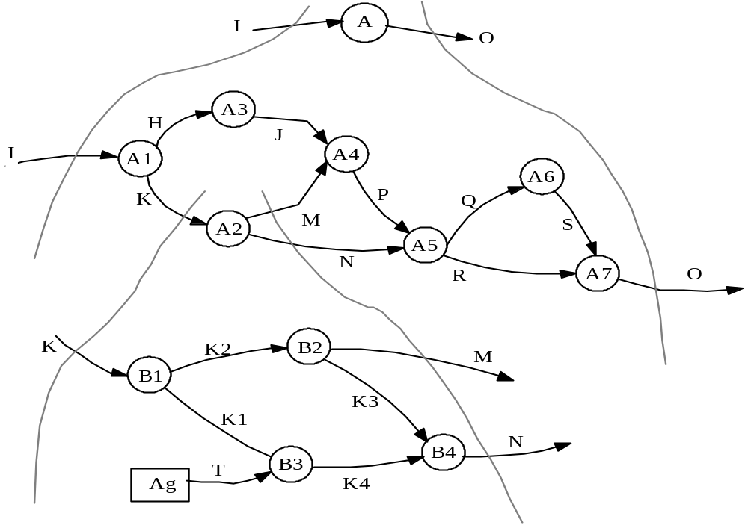
A Construction “Method” (2)
2. Proceed by refinements until you reach “elementary” functions (preserve balancing)
Notes:
And then proceed by refinements until the elementary functions are reached.

Slide 28
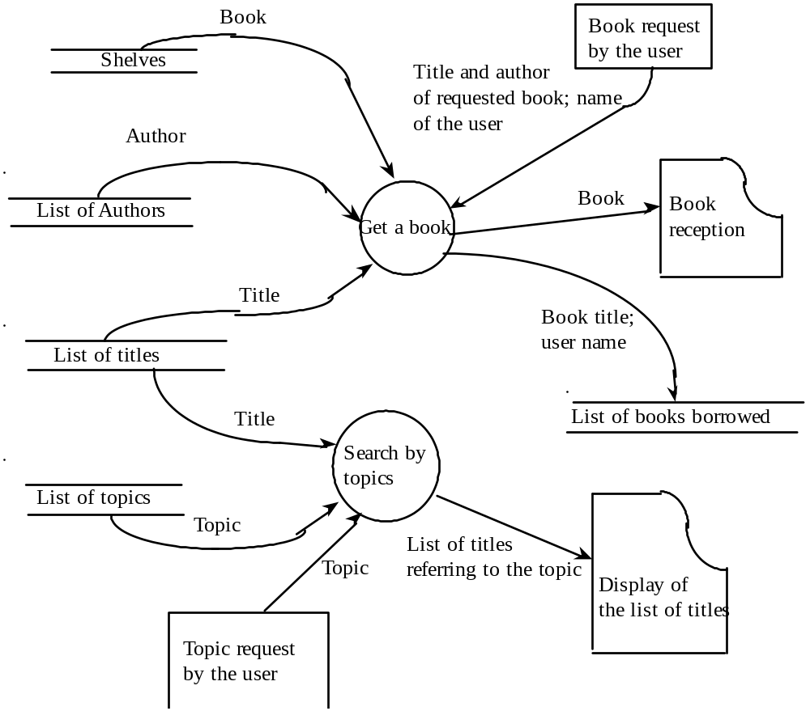
Data Flow Diagrams: A Library Example
“Search by topics” function comes before “Get a book”.
“Get a book” function to be refined: “Find book position” before “Get the book”
Figure 4.2
Notes:
Figure 4.2 describes a simplified information system for a public library. The data and functions shown are not necessarily computer data or computer functions. The DFD describes physical objects, such as books and shelves, together with data stores that are likely to be, but are not necessarily, realized as computer files. Getting a book from the shelf can be done either automatically by a robot or manually. In both cases, the action of getting a book is represented by a function depicted by a bubble. The figure could even represent the organization of a library with no computerized procedures.
The figure also describes the fact that, in order to obtain a book, the following are necessary: an explicit user request consisting of the title, the name of the author of the book, and the user's name; access to the shelves that contain the book; a list of authors; and a list of titles. These provide the information necessary to find the book.

Slide 29
Data Flow Diagrams: A Library Example
“Get a book” function to be refined: “Find book position” before “Get the book”
Get the book
<shelf#, book#>
Find
book position
Notes:
Figure 4.2 describes a simplified information system for a public library. The data and functions shown are not necessarily computer data or computer functions. The DFD describes physical objects, such as books and shelves, together with data stores that are likely to be, but are not necessarily, realized as computer files. Getting a book from the shelf can be done either automatically by a robot or manually. In both cases, the action of getting a book is represented by a function depicted by a bubble. The figure could even represent the organization of a library with no computerized procedures.
The figure also describes the fact that, in order to obtain a book, the following are necessary: an explicit user request consisting of the title, the name of the author of the book, and the user's name; access to the shelves that contain the book; a list of authors; and a list of titles. These provide the information necessary to find the book.

Slide 30
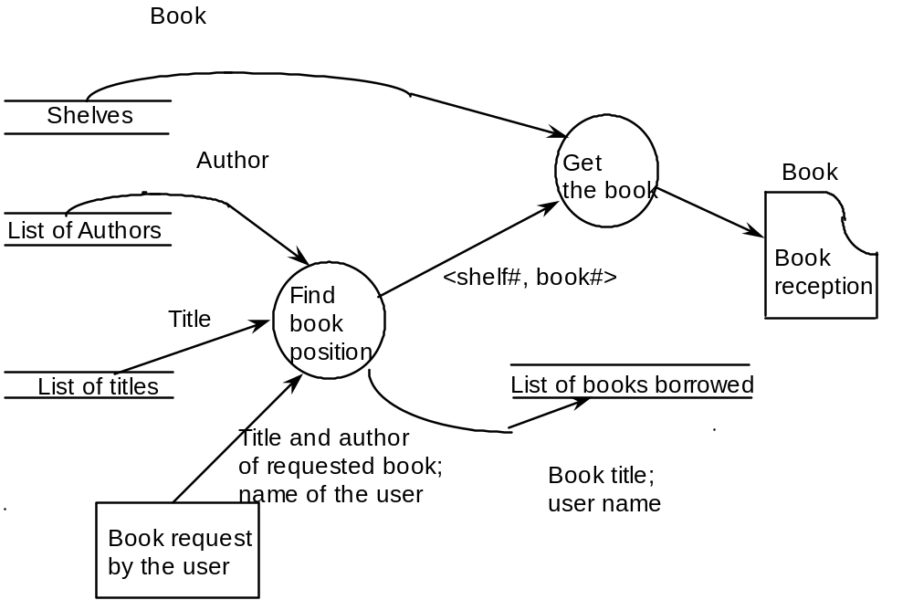
Refinement of “Get a Book”
Figure 4.3: A finer description (partial refinement)
Notes:
The way the book is actually obtained, however, is not at all mentioned in the figure. If we did not use our previous experience about the way one borrows a book from a library, there would be no way to deduce this information from the figure.
Thus, we should consider this DFD as a first approximation of the description of a library information system. A finer description of how a book can be selected from the library shelves is given in Figure 4.3, which can be seen as a refinement Figure 4.3 is still somewhat imprecise, in that it does not specify whether both the title of the book and the name of the author are necessary to identify a book or whether only one of them is enough. We do know that, in general, one is sufficient, but occasionally, both are necessary. This distinction, however, is not explained by the figure.

Slide 31
(A) Data Flow Diagrams
Drawback of the library spec
  (1) The semantics of the symbols might need further explanation.
    e.g., “find book position”
    Need both “author” and “title” or one is enough?
  (2) Control aspects are not defined by the model
    (i) relations of output are unspecified
      e.g. Figure 4.4
    (ii) synchronization between system components is unspecified
      e.g. Figure 4.5
In summary, DFD is an attractive graphical notation, but it still lacks a precise semantics. Thus, we call it a __semiformal__ notation.
Notes:
The semantics of the symbols used is specified only by the identifiers chosen by the user. Sometimes this is sufficiently precise; for example, the symbol '+‘ clearly denotes 'the function "add," and no further' explanation is needed. Other times, however, more explanation is necessary. For instance, the function "Find book position" of Figure 4.3 has some intuitive meaning, but does not fully specify what happens if some information is missing.
Control aspects are not defined by the DFD model. We explain the details in the next slide.
Therefore, DFD is an attractive graphical notation, but it still lacks a precise semantics. Thus, we call it a semi-formal notation.

Slide 32
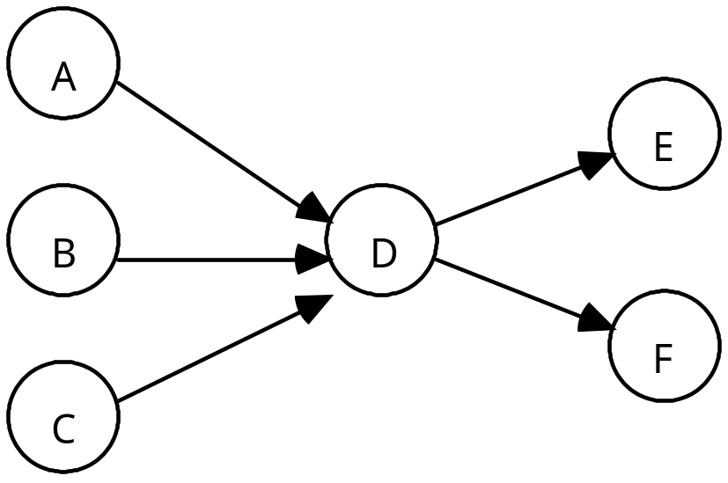
(A) Data Flow Diagrams
Outputs from A, B, C are
all needed? How about their order?
Outputs to E and F are the same?
Produced at the same time?
Figure 4.4
Notes:
Figure 4.4 shows a simple DFD in which the outputs of three bubbles, A, B, and c, are inputs to D and D’s two outputs are inputs to the bubbles E and F. By itself, this diagram does not specify clearly the way in which inputs are used and outputs are produced by the function D. In particular, there are many different, equally plausible alternatives for both input and output.
For the outputs, D may output a result just to one of the two output bubbles E and F, again in a nondeterministic, but exclusive way. D may output the same data to both E and F. D may output distinct data to E and F.
Other interpretations of D's inputs and outputs are also compatible with Figure 4.4.

Slide 33
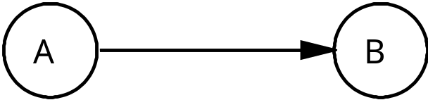
(A) Data Flow Diagrams
Control information is absent
Figure 4.5
Possible interpretations:
A produces datum, waits until B consumes it
A and B are autonomous activities that have different speeds
  (b1) B can read the datum in buffer from A, and consume it
  (b2) a pipe is inserted between A and B for continuous update
Notes:
Another case where DFDs leave synchronization between components of a system completely unspecified is shown in Figure 4.5, where two bubbles A and B are connected by a single data flow, with A's output being B's input. There are at least two possible interpretations of this DFD:
A produces a datum and then waits until B has consumed it. (This is often the case when A an d B denote arithmetic operations on simple data.)
A and B are autonomous activities that have different speeds, but (1) there is a buffering mechanism between them (some sort of a bounded buffer) which ensures that no data are lost or duplicated. (2) an unbounded pipe for continuous update (for instance, if A denotes computing the time spent by employees in their work and B denotes computing a payroll).

Slide 34
(A) Data Flow Diagrams
To overcome the DFD drawbacks
  Use a complementary notation to describe those
  aspects not captured by DFD
    e.g., use “hybrid” notations (such as English)
  2. Augmented DFD model to cope with extra aspects
    e.g., introducing control flow arrows (dashed)
      See Figure 4.6
      A partial DFD augmented with ___control flow arrows__
  3. Revise the DFD to make it fully formal
    (i) use different notations
    (ii) annotate the diagram
    (iii) formally specify each function
Notes:
Several methods have been designed to overcome these difficulties. They can be classified roughly as follows.
Using a complementary notation to describe those aspects of the system that are not captured adequately by DFDs. Thus, the complete system specification will consist of the integration of different descriptions provided in different notations.
Augmenting the DFD model in order to cope with aspects that are not captured by its traditional version. For instance, we can handle control aspects by introducing control flow arrows. A control flow' arrow going to a bubble means that the computation of the function associated with the bubble may occur only when a signal is present in the arrow. Figure 4.6 shows the notation and an example of the use of control flow arrows.
Revising the traditional definition of a DFD to make it fully formal. For example, one could define a formal DFD model that would make it possible to express all desirable interpretations of original DFDs in an unambiguous fashion. Thus, one might use different notations to distinguish the case where the arrow between two bubbles specifies the flow of a single datum from that where the arrow represents a pipe. One could also annotate the diagram to specify whether all input data flows are needed, or whether only one is required, to compute the function performed by a given bubble. Finally, one could provide a notation that would formally specify the function performed by a bubble.

Slide 35
(A) Data Flow Diagrams
Trigger
d₁
d₂
Σ
…
d_{n}
Figure 4.6 A partial DFD augmented with control flow arrows. The trigger
is a control flow arrow. It is dashed rather than continuous. The
function “sum” associated with the bubble is applied to all data
existing in the boxes as soon as a trigger (Boolean) occurs.
Notes:
A partial DFD augmented with control flow arrows. The trigger is a control flow arrow. It is dashed rather than continuous.
The function “sum” associated with the bubble is applied to all data existing in the boxes as soon as a trigger occurs.

Slide 36
Unified Modeling Language
The Unified Modeling Language (UML) is a general-purpose, developmental, modeling language in software engineering to visualize system design.
UML shows a system's architectural blueprints:
  any activities (jobs);
  individual components of the system; and how they can interact with other software components;
  how the system will run;
  how entities interact with others (components and interfaces);
  external user interface.
Notes:
The Unified Modeling Language (UML) is a general-purpose, developmental, modeling language in the field of software engineering, that is intended to provide a standard way to visualize the design of a system.
UML offers a way to visualize a system's architectural blueprints in a diagram, including elements such as:
any activities (jobs);
individual components of the system; and how they can interact with other software components;
how the system will run;
how entities interact with others (components and interfaces);
external user interface.
UML diagrams represent two different views of a system model:
Static (or structural) view: emphasizes the static structure of the system using objects, attributes, operations and relationships. It includes class diagrams and composite structure diagrams.
Dynamic (or behavioral) view: emphasizes the dynamic behavior of the system by showing collaborations among objects and changes to the internal states of objects. This view includes sequence diagrams, activity diagrams and state machine diagrams.

Slide 37
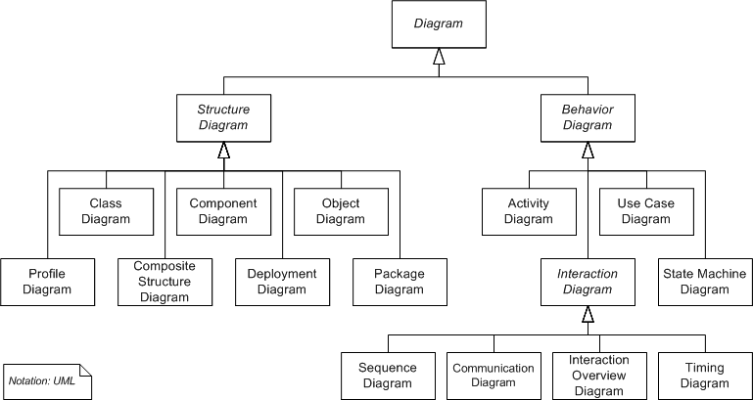
Unified Modeling Language
System model views: static/structural vs dynamic/behavioral.
Notes:
UML diagrams represent two different views of a system model:
Static (or structural) view: emphasizes the static structure of the system using objects, attributes, operations and relationships. It includes class diagrams and composite structure diagrams.
Dynamic (or behavioral) view: emphasizes the dynamic behavior of the system by showing collaborations among objects and changes to the internal states of objects. This view includes sequence diagrams, activity diagrams and state machine diagrams.
We extract four different diagrams for further explorations: Class Diagram, Use Case Diagram, Activity Diagram, and Sequence Diagram.

Slide 38
UML Use-case Diagrams
UML extends from DFD to cover both requirement specification and design specification, with objection orientation and control flow information.
Use-case diagrams define functions on basis of actors and actions from a global view
borrow
book
return
book
librarian
customer
library
update
Notes:
UML is an extension of DFD, and it covers both requirement specification and design specification with object orientation and control flow information. UML includes a number of techniques, including use-case diagrams, class diagram, activity diagrams, sequence diagrams, and collaboration diagrams.
Use case diagrams provide a global view of the actors involved in a system and the actions that the system performs; which in turn provide an observable result that is of value to the actors.
Use case diagram describe the overall context of a system by partitioning the system's functionality into transactions that are useful to actors and showing how actors interact with them. Actors are an abstraction of an external person, process, or entity interacting with the system being described. Actors are linked to use cases by associations, which represent the communication path between the actor and the use case it participates in.
For example, consider the description of a library in the figure. The system allows customers to borrow and return books. These actions involve both customers and librarians. Librarians can update the library by inserting copies of new books and eliminating copies of old ones.

Slide 39
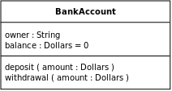
UML Class Diagrams
Static structure diagram that describes the structure of a system
  system’s classes
  their attributes
  operations (methods)
  relationships among objects
Classes are represented with boxes with
  top compartment: ___name___ of the class
  middle compartment: __attributes_ of the class
  bottom compartment: __operations__ of the class
Notes:
In software engineering, a class diagram in the Unified Modeling Language (UML) is a type of static structure diagram that describes the structure of a system by showing the system's classes, their attributes, operations (or methods), and the relationships among objects.
The class diagram is the main building block of object-oriented modelling. It is used both for general conceptual modelling of the systematics of the application, and for detailed modelling translating the models into programming code. Class diagrams can also be used for data modeling.^{[1]} The classes in a class diagram represent both the main elements, interactions in the application, and the classes to be programmed.
In the diagram, classes are represented with boxes that contain three compartments:
The top compartment contains the name of the class. It is printed in bold and centered, and the first letter is capitalized.
The middle compartment contains the attributes of the class. They are left-aligned and the first letter is lowercase.
The bottom compartment contains the operations the class can execute. They are also left-aligned and the first letter is lowercase.
In the design of a system, a number of classes are identified and grouped together in a class diagram that helps to determine the static relations between them. With detailed modelling, the classes of the conceptual design are often split into a number of subclasses.
In order to further describe the behaviour of systems, these class diagrams can be complemented by a state diagram or UML state machine.

Slide 40
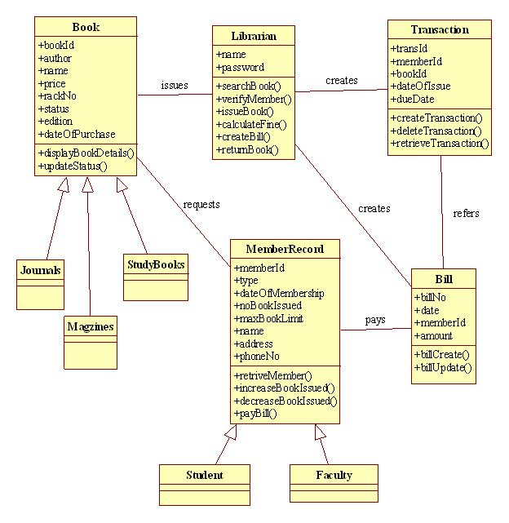
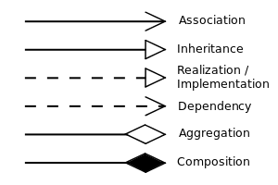
Class Diagrams Notation and Example
Class member visibility
+ | Public
- | Private
# | Protected
/ | Derived
~ | Package
UML relations notation
Notes:
This slide shows sample UML class diagrams for a library system.
To specify the visibility of a class member (i.e. any attribute or method), these notations must be placed before the member's name: public, private, protected, derived (can be combined with one of the others), and package.
Instance-level relationships includes Association, Inheritance, Realization/Implementation, Dependency, Aggregation, and Composition.

Slide 41
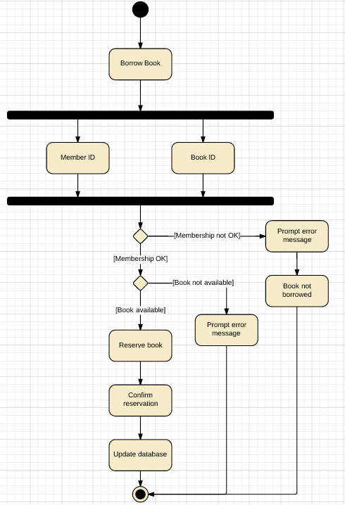
UML Activity Diagrams
UML Activity diagrams represent workflows of stepwise activities and actions with support for choice, iteration and concurrency.
  rounded rectangles represent _actions_;
  diamonds represent _decisions_;
  bars represent the start (split) or end (join) of ___concurrent___ activities;
  a black circle represents the start (initial state) of the workflow;
  an encircled black circle represents the end (final state).
Notes:
UML Activity diagrams are graphical representations of workflows of stepwise activities and actions with support for choice, iteration and concurrency. In the Unified Modeling Language, activity diagrams are intended to model both computational and organizational processes (i.e. workflows). Activity diagrams show the overall flow of control, in addition to data.
Activity diagrams are constructed from a limited number of shapes, connected with arrows. The most important shape types:
rounded rectangles represent actions;
diamonds represent decisions;
bars represent the start (split) or end (join) of concurrent activities;
a black circle represents the start (initial state) of the workflow;
an encircled black circle represents the end (final state).
Arrows run from the start towards the end and represent the order in which activities happen.
Activity diagrams may be regarded as a form of flowchart. Typical flowchart techniques lack constructs for expressing concurrency. However, the join and split symbols in activity diagrams only resolve this for simple cases; the meaning of the model is not clear when they are arbitrarily combined with decisions or loops.

Slide 42
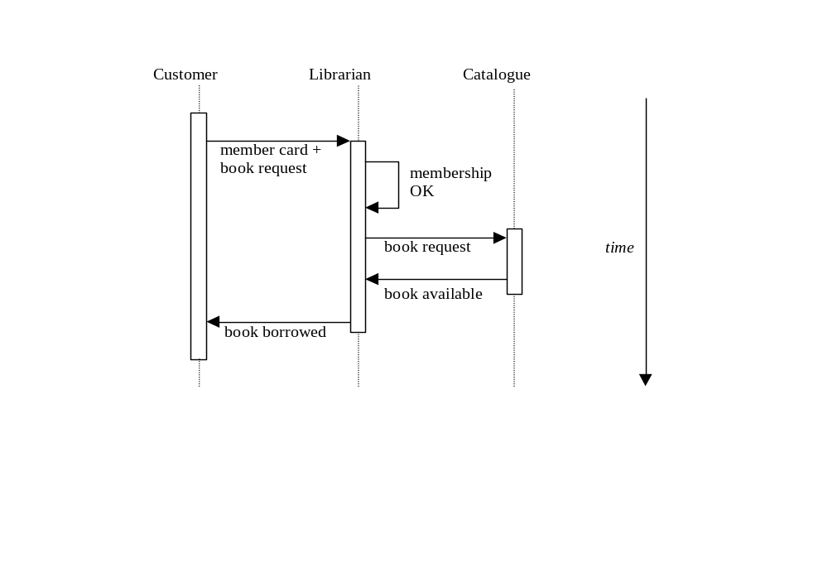
UML Sequence Diagrams
Describe how objects interact by exchanging messages
Provide a dynamic view
Notes:
As an example, the sequence diagram here illustrates a fragment of the specification of a library system by describing one of the scenarios that may occur when the customer of a library borrows a book.
In the scenario, first the customer provides his or her membership card to the librarian, and then the librarian checks whether the membership card is expired. If the card is valid, the catalogue is checked to see whether the book is available. If it is, then finally the customer can borrow the book.
The sequence diagram visually indicates the progression of time in the vertical direction and the temporal sequence of messages exchanged between objects (the customer, the librarian, and the catalogue).

Slide 43
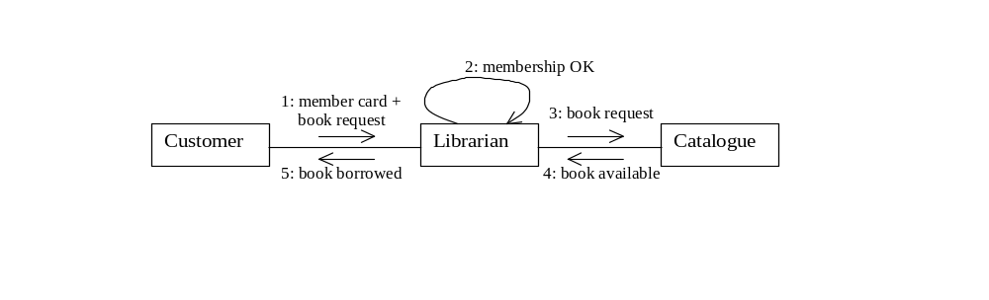
UML Collaboration Diagrams
Give object interactions and their order
Equivalent to __sequence__ diagrams
Notes:
The figure describes the same scenario by means of a collaboration diagram. The diagram indicates the objects involved in the interaction and describes the temporal sequence of events by numbering the relevant labels on the arcs connecting collaborating objects.
As we mentioned, sequence diagrams and collaboration diagrams are semantically equivalent, but syntactically different. The choice of which of the two to use is a matter of personal taste. Collaboration diagrams make the structural properties of a collaboration more evident, whereas sequence diagrams highlight the temporal evolution of the scenario.

Slide 44
(B) Finite State Machines (FSMs):
Control Flow
We need to describe control aspects of a system in order to make specs more precise.
FSM is suitable to describe a system that i) has a finite set of states, ii) can go from one state to another as a consequence of some event (input)
  Basic elements
    (1) a finite set of states, Q
    (2) a finite set of inputs, I
    (3) a transition function δ: Q × I → Q
    Note: δ can be a partial function (undefined for some values)
: __state__
i
: __input_
q_{j}
i
q_{k}
iff _δ(q_j,i)=q(k)
Notes:
In the description of information systems, the emphasis is on the organization of functions and data flows we saw. However, to make specifications more precise, some attention must be paid to control aspects as well.
For instance, sooner or later, one may wish to specify in a DFD whether the execution of a function must wait for all inputs or whether it can start as soon as some of them are available. In a similar way, programming languages have constructs both to describe data organization and to describe the flow of control.
To handle control flow of a system, we introduce the use of a very general technique, Finite State Machine (FSM). FSM is suitable to describe a system that i) has a finite set of states, ii) can go from one state to another as a consequence of some event (input).

Slide 45
(B) Finite State Machines (FSMs)
  Examples
    Figure 4.7
    Figure 4.8
    Figure 4.9, Figure 4.10 (a refined policy)
  State transition matrix: a matrix to denote the transition function δ
    e.g. Given an FSM of n states q₁ .. q_{n}
q
q
q_{k}
q
1
2
n
q
⎡
..
..
..
..
⎤
q_{j}
i
q_{k}
1
⎢
⎥
q
..
..
..
..
δ
=
2
⎢
⎥
iff δ(q_{j}, i) = q_{k}
q_{j}
⎢
..
..
i
..
⎥
out-going arcs
⎢
⎥
q
⎣
..
..
..
..
⎦
n
in-coming arcs
Notes:
This is a finite state machine example. Detailed explanations will come in the following slides.

Slide 46
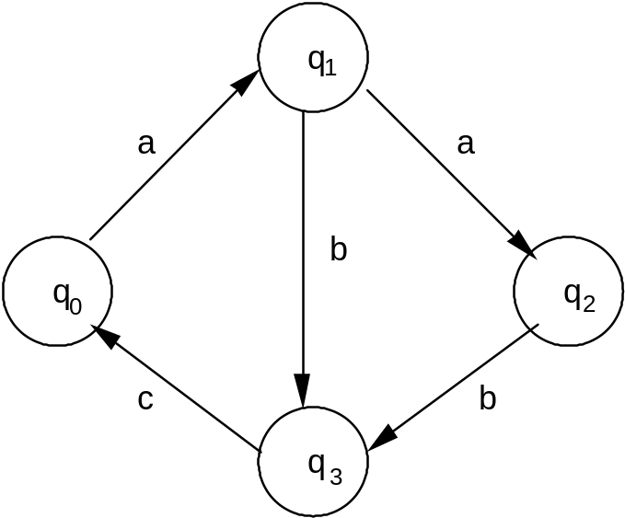
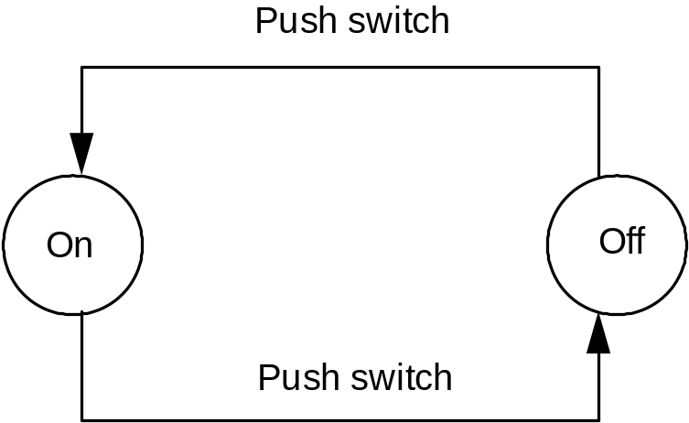
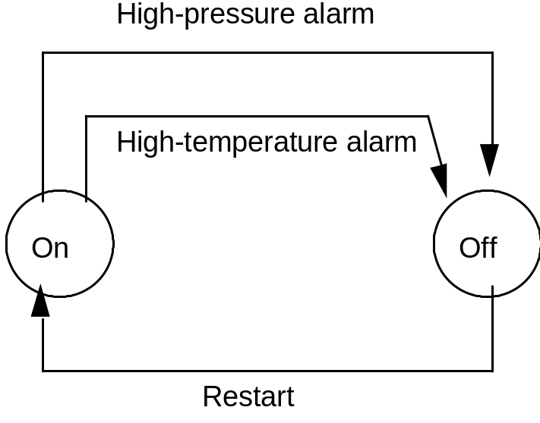
(B) Finite State Machines (FSMs)
Figure 4.8
Figure 4.7
Figure 4.9
Notes:
An FSM may be shown by a graph whose nodes represent states; an arc labeled i goes from q1 to q2 if and only if ( q1, i) = q2. Figure 4.7 shows a simple FSM.
As the term itself suggests, FSMs are suitable for describing systems that can be in a finite set of states and that can go from one state into another as a consequence of some event, modeled by an input symbol. For instance, a lamp can be either on or off and can go from on to off as the consequence of an external action consisting of pushing a button on the attached switch. Pushing the button again causes the opposite transition. This simple system is described by the FSM of Figure 4.8. Another simple example of the use of FSMs is given next.
Consider the control of a (small part of a) chemical plant. Temperature and pressure levels must be monitored for safety reasons. Sensors are installed to detect and generate appropriate signals when either of these levels exceeds some predefined values. A trivial. policy for managing the plant is the following: When either one of the signals is raised by the corresponding sensor, the control system shuts the plant off and raises an alarm signal; the system is restarted manually when the cause of the failure has been rectified. All this is described by the FSM of Figure 4.9.

Slide 47
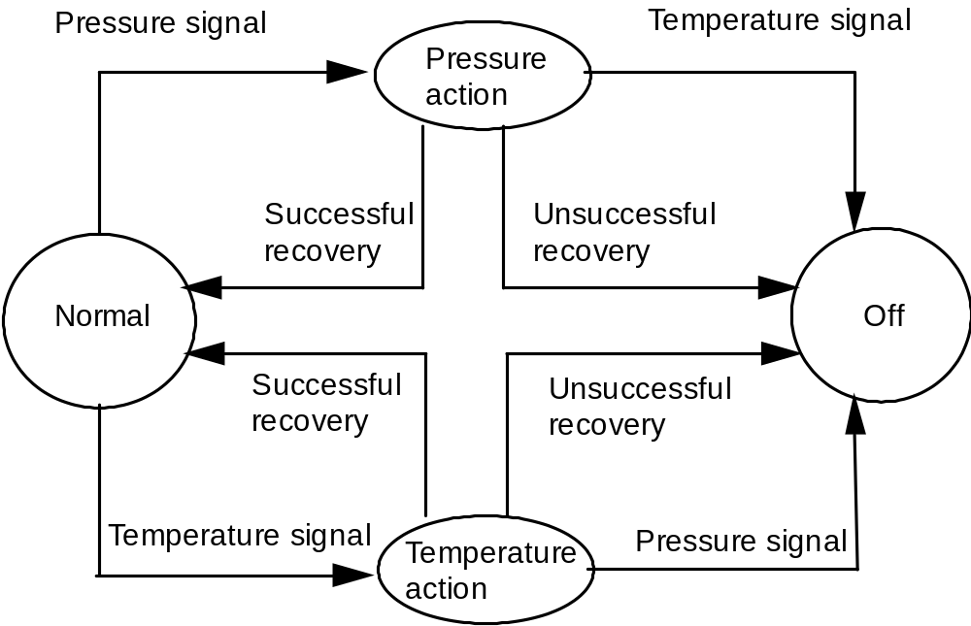
(B) Finite State Machines (FSMs)
Figure 4.10
Notes:
The simple policy describe in the previous slide is obviously inadequate. A better way of managing the plant is as follows: When one of the two signals is raised, the system enters a recovery state in which it tries to apply a recovery action. If, after a while, the recovery action succeeds, the system is, automatically reset to the ”normal" state, and a message, "everything OK," is issued to the external environment.
Otherwise, the alarm signal must be raised and the plant must be shut off. The system must also be switched off if it is trying to recover from one kind of anomaly-temperature or pressure and the other signal is raised. It is assumed that the two signals cannot occur simultaneously. This new policy is described by the FSM of Figure 4.10.

Slide 48
(B) Finite State Machines (FSMs)
q
q
q₂
q
0
1
3
- a - -
- - a b
b
c
q
⎡
⎤
0
⎢
⎥
q
⎢
⎥
δ
=
1
q₂
⎢
⎥
out-going arcs
⎢
⎥
q
⎣
⎦
3
in-coming arcs
Figure 4.7
Notes:
An FSM may be shown by a graph whose nodes represent states; an arc labeled i goes from q1 to q2 if and only if ( q1, i) = q2. Figure 4.7 shows a simple FSM.
As the term itself suggests, FSMs are suitable for describing systems that can be in a finite set of states and that can go from one state into another as a consequence of some event, modeled by an input symbol. For instance, a lamp can be either on or off and can go from on to off as the consequence of an external action consisting of pushing a button on the attached switch. Pushing the button again causes the opposite transition. This simple system is described by the FSM of Figure 4.8. Another simple example of the use of FSMs is given next.
Consider the control of a (small part of a) chemical plant. Temperature and pressure levels must be monitored for safety reasons. Sensors are installed to detect and generate appropriate signals when either of these levels exceeds some predefined values. A trivial. policy for managing the plant is the following: When either one of the signals is raised by the corresponding sensor, the control system shuts the plant off and raises an alarm signal; the system is restarted manually when the cause of the failure has been rectified. All this is described by the FSM of Figure 4.9.

Slide 49
(B) Finite State Machines (FSMs)
FSMs to specify sets of acceptable strings
  augmented terms
    (1) one initial state, q₀ ∈ Q
    (2) a set of final states, F, F ⊂ Q (denoted by double circled nodes)
    (3) a finite set of outputs, O
    (4) the transition function δ is augmented to produce output signals
    δ: Q × I → Q × O
_Moore_ machine: output
determined by current state
_Mealy_ machine: output
determined by current state
and input
q_{j}
i
q_{k}
o
iff δ(q_{j}, i) = (q_{k}, o)
Notes:
An input string is accepted by the FSM if and only if there is a path in its graphical representation leading from q0 to any final state such that the concatenation of the labels of the edges of the path is the input string.
For instance, the machine of Figure 4.11 accepts the words begin and end. The machine of Figure 4.12 accepts the valid identifiers of a programming language.

Slide 50
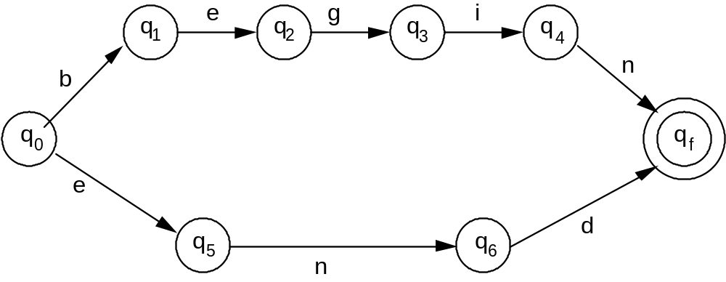
FSMs as Recognizers
Assume the input is a token (no space).
q_{o} is an initial state
q_{f} is a final state
Figure 4.11 An FSM accepting the keywords __begin_ and ___end___
Note: If there is any other letter, then it won’t be accepted.
Notes:
This FSM recognizes the strings “begin” and “end”. There is no loop in this FSM. We assume the input is a token (no space). IF there is any other letter, then the keyword won’t be accepted.

Slide 51
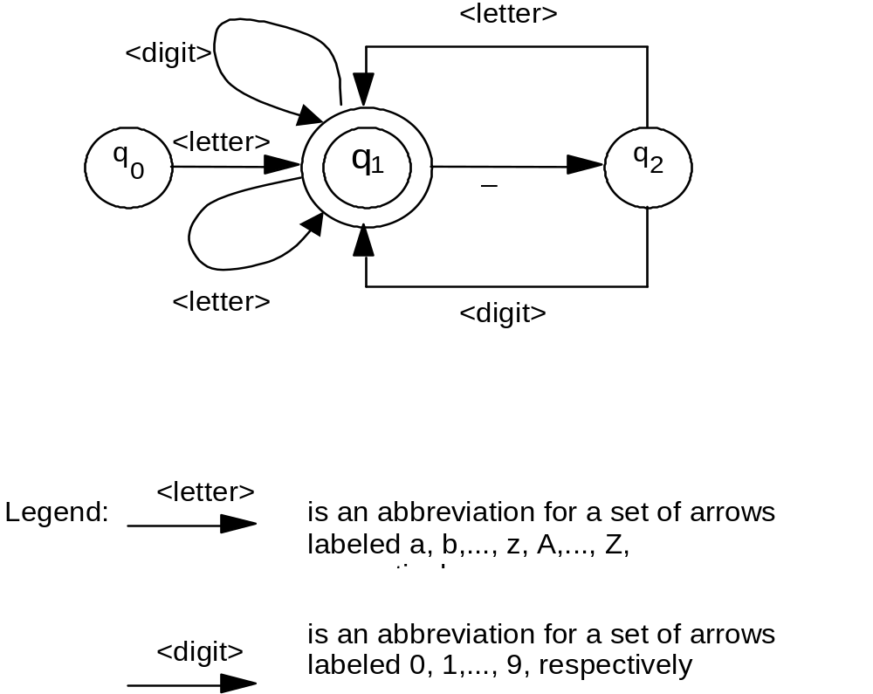
FSMs as Recognizers
Figure 4.12 An FSM accepting the
identifiers of a programming language
Notes:
This FSM accepts the identifiers of a programming language. There are loops in this FSM.

Slide 52
(B) Finite State Machines (FSMs)
Summary about FSMs
  advantages:
    (1) simple
    (2) widely used
      • especial in Compiler, P.L., AI
  disadvantages:
    (1) Its computational power is limited due to finite memory. e.g., hard to deal with real numbers whose possible values are infinite.
    (2) Number of states may be explosive
        • Q: How many states are needed to describe a 8-byte long register?
        • A: _________________different states!
    (3) FSMs are essentially a synchronous model - inappropriate for concurrent and asynchronous components in a system.
2³²
Notes:
FSMs are essentially a synchronous model. (At any time, a global state of the system must be defined and a single transition must occur.)
Other models are more appropriate for describing systems consisting of concurrent and asynchronous components, more so if timing aspects (i.e., stating time-constraints for the completion of several transitions) are important. In the next part, we present and evaluate an operational model that is explicitly aimed at describing concurrent systems.

Slide 53
(B) Finite State Machines (FSMs)
  Improvements:
    (1) describe an approximation to the system without too much details
    (2) modify and change the FSM model
    (3) enrich the model by new features (e.g., add more complex predicates for state transitions)
Notes:
We may give up on describing all details of the system and be satisfied with an approximation that ignores requirements of the type just discussed. After all, Figure 4.10 provides some meaningful information even without specifying the "amount of cooling effort“ for a successful recovery from “Temperature action” state.
We may complement the diagram with informal natural-language comments. We may change models. Actually, a large variety of other models has been proposed to overcome this and other problems of FSMs.
Some appear as modifications of the original FSM; others are totally different models. We may enrich the model by adding new features to the description to cope with the new requirement.

Slide 54
(B) FSMs: State Explosion Problem
♦ Example:
  1. A producer process -
    produces messages and puts (writes) them into a
    buffer
  2. A consumer process -
    reads and removes the messages, and consume
    them
  3. A buffer -
    a two-slot buffer to store messages
  Figure 4.13: three components
  Figure 4.14: describe the whole system
Notes:
A producer process produces messages and puts them into a two-slot buffer. A consumer process reads the messages and removes them from the same buffer.
If the buffer is full, the producer must wait until the consumer process has emptied a slot. Similarly, if the buffer is empty, the consumer process must wait until the producer has inserted a message. The two processes and the buffer may be described separately by the FSMs of Figure 4.13.
Although it can be useful to examine the three components separately, it is clear that the two processes, together with the buffer, are a single, synchronized system that must also be described as a whole.

Slide 55
(B) FSMs: State Explosion Problem
produce
Producer
p
1
p
2
write
read
Consumer
c
1
c
2
consume
Figure 4.13
write
write
Buffer
0
1
2
read
read
Notes:
A natural way of attacking this problem is to compose the different FSMs to obtain a new FSM that describes the whole system. Intuitively, the resulting state set should be the Cartesian product of the component state sets; furthermore, arcs denoting the same action in different components should become single arcs in the resulting graph.
Applying this composition to Figure 4.13, we would obtain the result shown in Figure 4.14. In this FSM, a state such as <0 , p2 , c2> corresponds to the buffer being empty, the. producer being in state p2, and the consumer being in state c2.

Slide 56
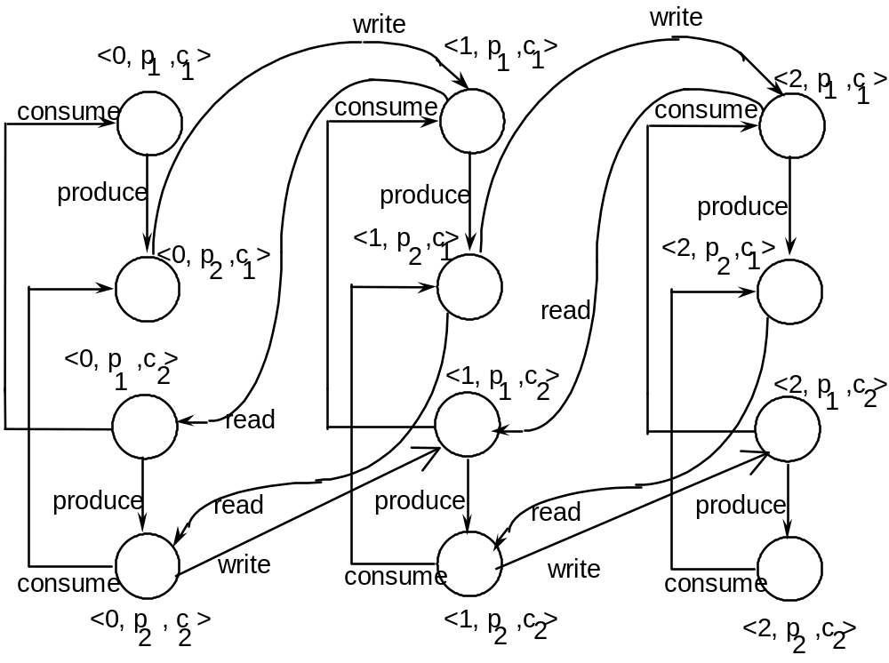
(B) FSMs: State Explosion Problem
message in buffer
producer’s state
consumer’s state
Q: How many
states are there?
Figure 4. 14
Notes:
The approach, however, is not without drawbacks. First, we see that, even in the fairly simple case under consideration, the cardinality of the state space grows dramatically: If we compose n subsystems, each with ki states, the resulting system has a cardinality of k1, k2… kn.
This objection, however, is mitigated somewhat by the consideration that what we need is actually a complete description of the system, not a complete FSM describing the system.
Thus, we can argue that full information about the system is given by the three components of Figure 4.13, augmented with precise even algorithmic rules for composing FSM "modules" into "full FSMs," with no need for the explicit description the figure in this slide. In some sense, we have built a modular specification of the system, leaving its integration to a straightforward "FSM linker."

Slide 57
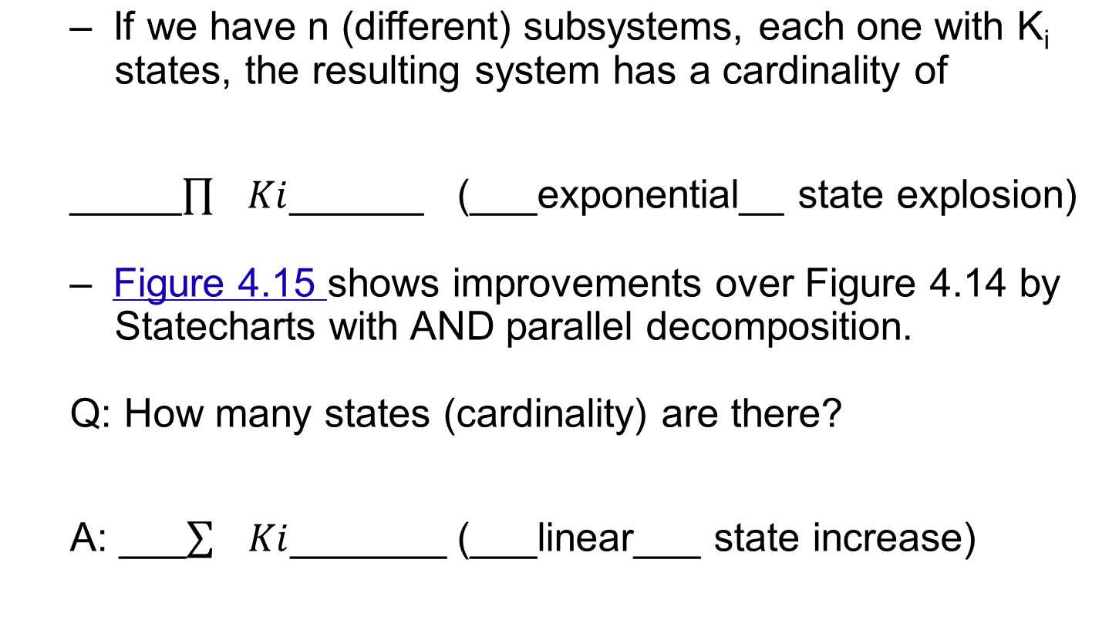
(B) FSMs: State Explosion Problem
Notes:
Still, there is a more serious objection to the use of FSMs for the description of systems that consist of several concurrent units. If we look at the figure in the previous slide, we realize that it is an adequate description of the system under certain somewhat restrictive assumptions. Basically, the system described is always in a unique state and performs exactly one action at any instant of time. There is, however, no reason to impose a serialization between production by the producer and consumption by the consumer, two actions that are absolutely independent.
A possible rebuttal to this objection is that the figure is still an adequate specification of the concurrent system because the effect of two concurrent-and compatible actions. say a write and a consume, is the same as the effect of any serialization of the two actions, either write followed by consume or consume followed by write. This answer is partially true. It works fairly well if we can assume that the time for any transition is short enough that, for example, at any instant t we can say "the present state of the system is <1, p1, c2>.” In such a case, we could even define new transitions that are the "parallel execution" of elementary transitions in order to cope with truly simultaneous events.

Slide 58
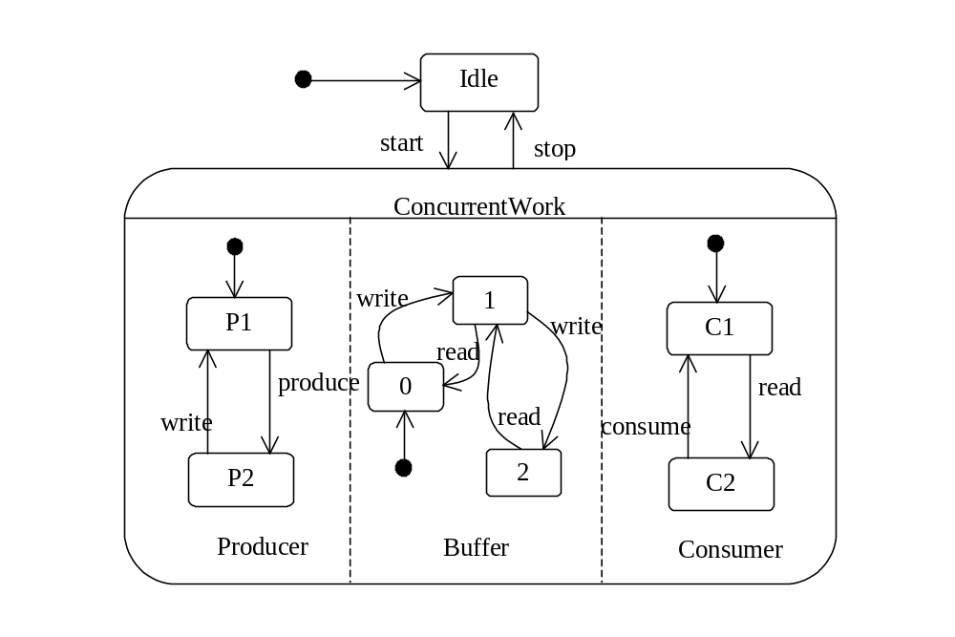
(B) FSMs with Parallel Decomposition
  Figure 4.15 Statecharts with AND parallel decomposition.
Notes:
Instead, suppose that the various operations take fairly different execution times; for example, consuming is longer than producing, which in turn is far longer than reading from and writing into the buffer. In this case, it may happen that the producer and consumer start together (producing and' consuming, respectively).
After a while, the producer is finished with producing and may start writing. This, again, may be finished before the consumer is finished with its original operation; and a new instance of production may start. Thus, we see that the transitions of the various components occur in an asynchronous way that is no longer described well by the FSM in the previous two slides.

Slide 59
(C) Petri Nets:
Specifying Asynchronous Systems
[Petri 1962] C.A. Petri Ph.D Dissertation U of Bonn.
Basic elements:
  a finite set of places (circles): P
  2) a finite set of transitions (bars): T
  3) a finite set of arrows connecting places and
  transitions (with a weight integer if necessary): F, W
_place__
transition
When W is omitted, it is consider default (1).
2
flow relation
Notes:
To overcome the disadvantages of FSM, we will then introduce the Petri Nets.
Petri nets are a formalism for specifying systems that contain parallel or concurrent activities. They are defined by a quadruple (P, T, F, W).

Slide 60
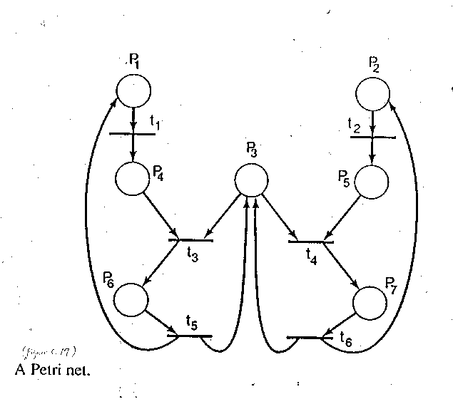
(C) Petri Nets
A quick preview sample:
_7_ places
_6_ transitions
_16_ flow relations
Figure. 4.16
Notes:
This is a quick example Petri net.

Slide 61
(C) Petri Nets
A quadruple (P,T,F,W)
P: places T: transitions (P, T are finite)
F: flow relation (F ⊆ {P×T} ∪ {T×P} )
W: weight function (W: F → N – {0} )
Properties:
(1) P ∩ T = Ø
(2) P ∪ T ≠ Ø
(3) F ⊆ (P × T) ∪ (T × P)
(4) W: F → N-{0}
Default value of W is 1
State defined by marking: M: P → N
Notes:
A Petri net (PN) can be given an appealing graphical representation, which makes specifications intuitively understandable. Places are represented by circles, transitions by bars, and flow elements by arrows.
Whenever useful, a bi-directional arrow connecting a place P and a transition t will be considered as an abbreviation for a pair of arrows, one going from P to t, the other going from t to P. Figure 4.16 shows a sample Petri net.

Slide 62
(C) Petri Nets
Operations of a Petri Net (PN)
  state: a PN is given a state by marking its places.
  marking: assign a token to each place of a PN.
  token: a non-negative integer (usually 0 or 1) inserted to the places of a PN.
  input place (_conditions_): if an arrow goes from a place to a transition (_actions_ or __events__), the place is one of the transition’s input places.
    “enough tokens in a place” means “__condition met__”
  output place: if an arrow goes from a transition to a place, the place is one of the transition’s output.
  enable: a transition is enabled if there is enough tokens in each of its input places satisfying the weight requirement.
Notes:
A PN is given a state by marking its places. Formally, a marking is a function M from places to natural numbers.
A marking is represented graphically by inserting a number x of tokens in every place of the net, such that x = M (p) . Figure 4.16(a) shows one marking of the PN of Figure 4.16. The evolution of a PN-that is, its progression through state changes, is regulated by the rules explained next.
A transition may have one or more input and output places. If an arrow goes from a place to a transition, the place is said to be one of the transition's input places; if an arrow goes from a transition to a place, the place is said to be one of the transition's output places.
A place can be both an input and an output for a transition. A transition is said to be enabled if each of its input places contains a number of tokens that is greater than or equal to the weight of the flow element connecting the input place to the transition. In the default case, where the weight of the flow element is one, each input place must contain at least one token. A transition with no input places is always enabled.

Slide 63
(C) Petri Nets
  fire: the number of “input weight” tokens are removed from each input place and the number of “output weight” tokens are inserted in each output place of the transition. An enabled transition may fire.
  non-determinism: given an initial marking, different evolutions of the PN are possible.
  firing sequence: a sequence of transition firings, denoted as a string of transition labels <t₁,t₂,…,t_{n}>, such that t₁ is fired in the initial marking, then t₂ is fired, and so on.
    Example: Figure 4.16(a)
  concurrent transitions: firing of one transition does not prevent the other from firing. (t₁, t₂)
  conflict transitions: firing of one transition does prevent the other from firing (mutual exclusion). (t₃, t₄)
Notes:
An enabled transition may fire. The firing of transition t removes from each input place pi a number of tokens that equals the weight of the flow element from pi to t and then inserts into each output place q, a number of tokens equal to the weight of the flow element from t to qi. In Figure 4.16(a), both ti and t2 are enabled; no other transition is enabled.
In such a case, the marking of the net may evolve in at least two different ways: either by firing t1 or by firing t2. Thus, the model is nondeterministic, in the sense that given an initial marking, different evolutions of the PN are possible. In the case of Figure 4.16(a), the firing of t1 produces the marking of Figure 4.16(b), whereas the firing of t2 produces the marking of Figure 4.16(c).
Notice that, after t1 fires, t2 is still enabled and could fire. Correspondingly, t1 would still be enabled if t2 fires first. Transitions t1 and t2 can also fire in parallel. In any case, one would eventually reach the marking of Figure 4.16(d). At this point, t3 and t4 are both enabled, and either can fire in a nondeterministic way. This time, however, the firing of one prevents the other from firing. For example, if t3 fires, t4 will no longer be enabled.
The animation of this Petri net operation is shown in the next slide, where Figure 4.16(b)-(d) overlaps with Figure 4.16(a).

Slide 64
(C) Petri Nets
A sample PN:
Figure. 4.16(a)
Notes:
This is an animated slide. Check the previous slide for explanation.

Slide 65
(C) Petri Nets
  starvation: a process that never receives access to a needed resource.
    starvation may happen due to “scheduling policy”
    put two tokens in P₃ { no _conflict_________
    no _starvation______
    Q: Should we separate the independent parts for a equivalent model?
    A: __No__, because:
    (1) _2 tokens in P3 could be shared_______________
    (2) _we are interested in the figure sequence_________
    The extreme of starvation when everybody starves: ___deadlock___ see Figure 4.17
Notes:
Suppose that the resource is given to the activity on the left-hand side of the figure. Then the net can proceed through t3 and t5, leaving the other activity temporarily blocked. The firing of t5 frees the resource, which is now available again for further use. At this point, t4 could fire. But it is also possible that, on the contrary, t1 fires again, and then the choice between t3 and t4 is resolved once more in favor of t3. This sequence of events can be repeated forever.
The model does not impose any policy to resolve conflicts In the concurrent system terminology, the scheduling policy is not fair, and a process that never receives access to a needed resource is said to suffer starvation. Thus, a firing sequence where only transitions t1, t3, t5 occur leads to starvation of the activity on the right-hand side of the figure.
Now, assume that the initial marking of the PN has two tokens in P3 instead of one. This means that two indistinguishable resources are available. As a consequence, t3 and t4 are no longer in conflict, but are concurrent. lf the two activities represent computer processes, and two CPUs are available for them in a multiprocessor machine, the two processes may be executed in parallel.

Slide 66
(C) Petri Nets
Figure 4.16(a) with a different marking

Slide 67
(C) Petri Nets
P_{3A}
P_{3B}
Figure 4.16(a) with a different marking

Slide 68
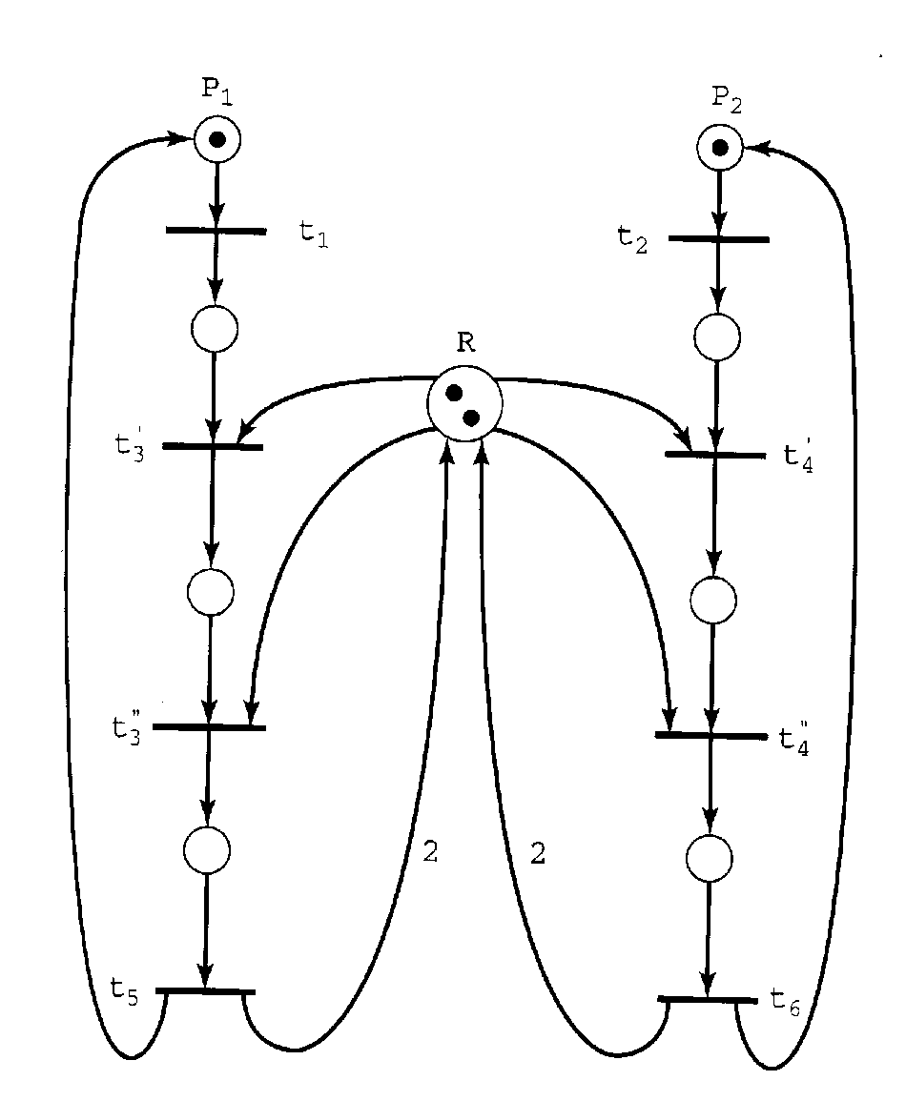
(C) Petri Nets
Figure. 4.17
A Petri net that can enter a deadlock state
Notes:
This figure is a modification of Figure 4.16(a) that models the case where the two activities need two identical copies of a resource to proceed. These copies are modeled by two tokens in place R. After an activity, say, the leftmost starts by firing t1, it may obtain any one of the available resources (firing t’3) Then, it 'attempts also to obtain the other resource (firing t’’3) Once the activity has obtained-both resources, execution can proceed, eventually releasing both (firing t5).
Consider, however, the firing sequence <t1, t’3, t2, t’4>, which leads to a marking wherein no transition is enabled. Thus, the net is prevented from any further progress. Each of the activities has obtained one of the two resources and needs the other one to go further. But this cannot happen, because the needed resource is owned by the other activity, which is also waiting for one more resource.
This is a typical deadlock, which is modeled quite well by a PN. Formally, a PN with a given marking is said to be in deadlock if and only if no transition is enabled in that marking. A PN in which no deadlock can ever occur starting from a given marking is said to be live.

Slide 69
(C) Petri Nets
  deadlock: a PN with a given marking is said to be in deadlock iff no transition is enabled in that marking.
  live: a PN without deadlock.
    E.g. Figure 4.18
    Q: deadlock → starvation ?
      • ___Yes__________
    Q: starvation → deadlock ?
      • ___No___________ see Figure 4.19
  Main advantages over FSM: reduce state explosion!
  Revisit of Producer-Consumer-Buffer example
Notes:
Formally, a PN with a given marking is said to be in deadlock if and only if no transition is enabled in that marking. A PN in which no deadlock can ever occur starting from a given marking is said to be live.
Deadlocks lead to system "freezes." Designers obviously try to avoid deadlocks, but detecting them is difficult. Modeling formalisms such as Petri nets make it possible to analyze properties of the system. In this example, we were able to derive the deadlock property of a system by manually analyzing the PN that models the system.

Slide 70
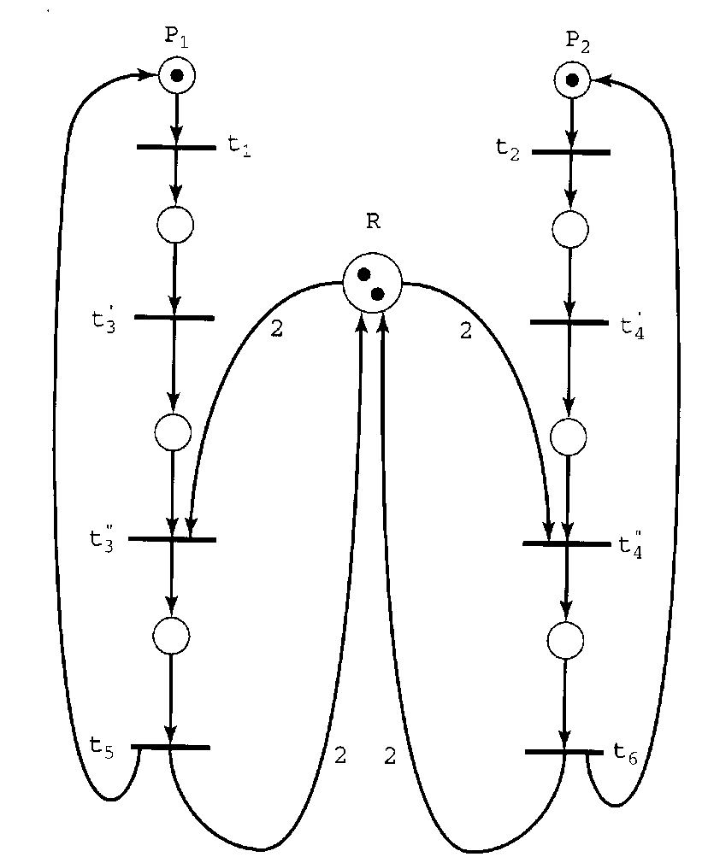
Modification of PN to Avoid Deadlock
Figure. 4.17
A Petri net that can enter a deadlock state
Figure. 4.18
A modification of the Petri net of Figure 4.17 that is live.
Notes:
Figure 4.18 shows a modification of the Petri net that is alive from Figure 4.17.

Slide 71
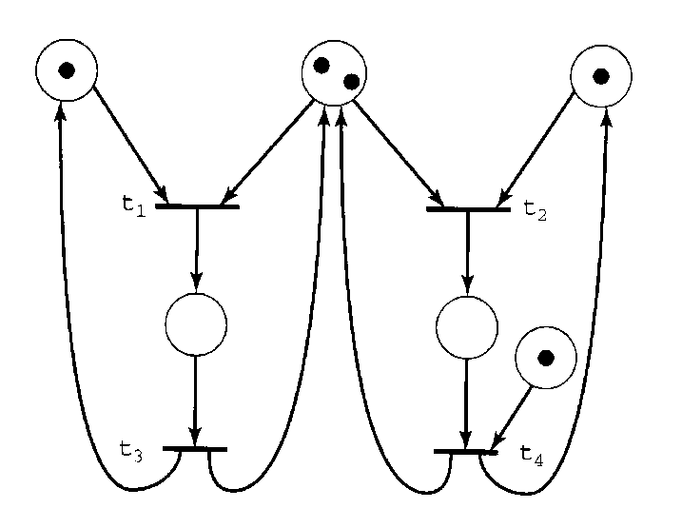
A Starving PN without Deadlock
Figure. 4.19
A Petri net with partial starvation.
Notes:
Figure 4.19 shows a Petri net with partial starvation.

Slide 72
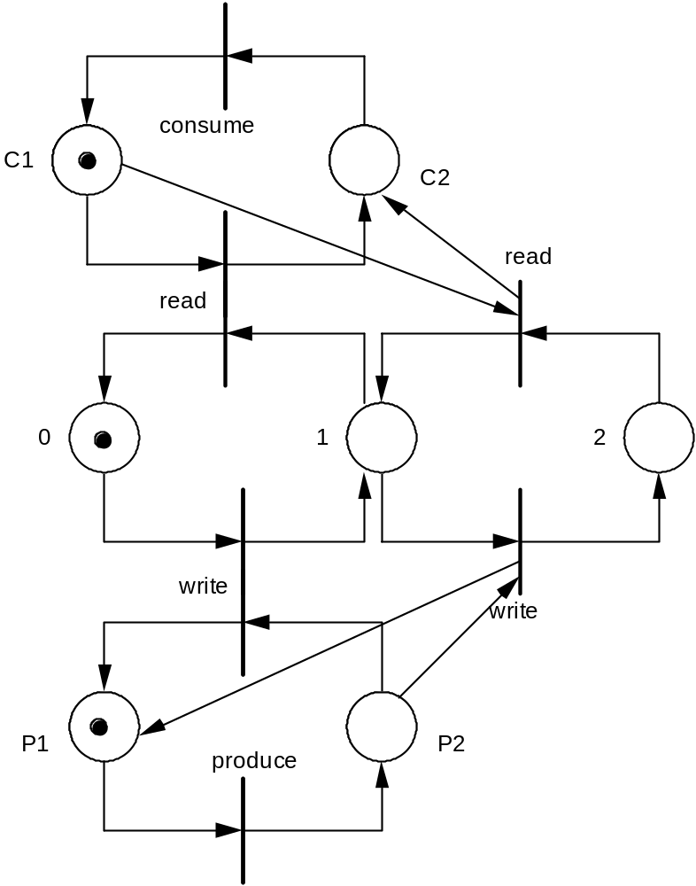
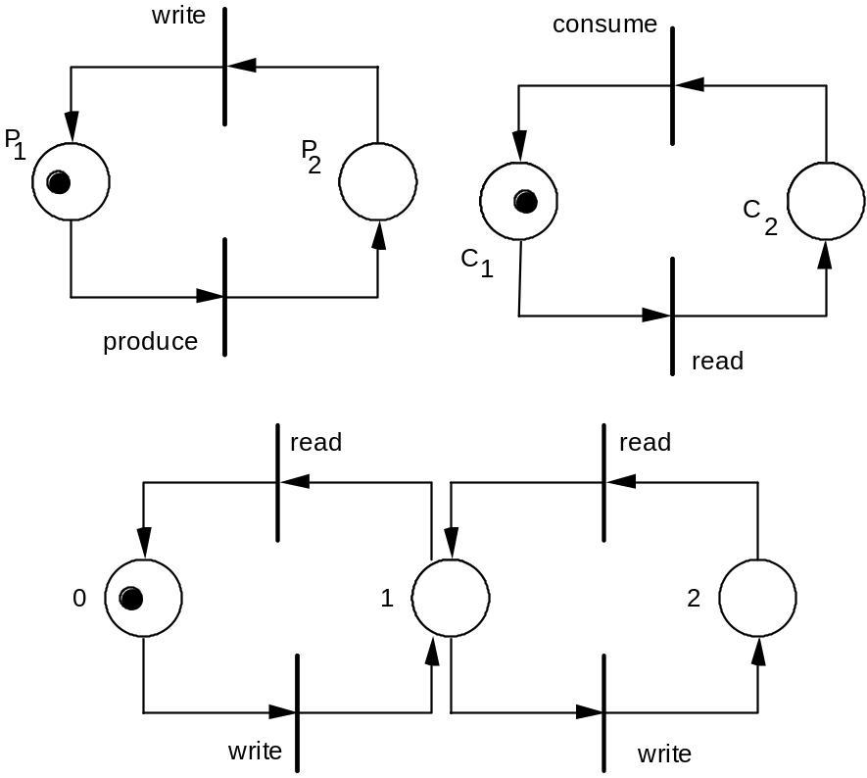
(C) Petri Nets: Producer-Consumer Example
⇒
integration
Figure. 4.20
Notes:
Figure 4.20: This Petri net shows a producer-consumer example.

Slide 73
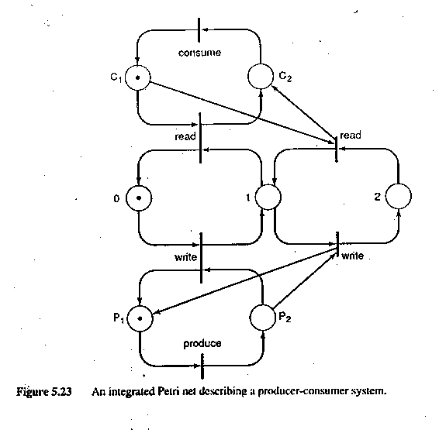
(C) Petri Nets: Producer-Consumer Operation
Figure. 4.21
An integrated Petri net describing
a producer-consumer system.
history: <produce, write, produce, read, consume, write, read, consume>
Notes:
In Figure 4.21, the concurrency of independent activities is described properly. In fact, if the system is in the state <1, p1, c2> (i.e., a token is in each one of those places), both of the transitions produce and consume are enabled. That is, the two transitions are concurrent. They can be executed in parallel without preventing each other from firing. Also, looking at the firing sequence
<produce, writer produce, read, consume, write, read, consume>
shows immediately which actions could happen concurrently and which ones have to be serialized because the termination of one is necessary for the start of the other.

Slide 74
(C) Petri Nets
advantages over FSM:
  Graphical complexity - state space of the components is only additive, not multiplicative
    Major reduction of model complexity
  The concurrency of independent activities is described properly by a __firing sequence_.
    E.g. <produce, write, produce, read, consume, write, read, consume>
  Easy to ____modify_____.
Notes:
Let us go back to the producer-consumer system modeled as an FSM. We can use the PNs of Figure 4.20 to describe the three separate components of the system. Graphically, the composition of the three subsystems into a PN is shown in Figure 4.21. The figure shows that the major drawbacks of the corresponding FSM representation (given in Figure 4.14) are now resolved satisfactorily. First, the graphical complexity of the figure is not based on multiplying the state space of the components, but is only additive.
In fact, in Figure 4.14 the number of nodes coincided with the number of states. In Figure 4.21, the number of states is given by the number of possible markings. The reader is invited to compare a PN describing a system of two producers and three consumers using a four-position buffer with the corresponding FSM representation.
Second and more importantly in Figure 4.21, the concurrency of independent activities is described properly. In fact, if the system is in the state<1, p1, c2> (i.e., a token is in each one of those places), both of the transitions produce and consume are enabled. That is, the two transitions are concurrent. They can be executed in parallel without preventing each other from firing. Also, looking at the firing sequence <produce, writer produce, read, consume, write, read, consume> shows immediately which actions could happen concurrently and which ones have to be serialized because the termination of one is necessary for the start of the other.
The third advantage of Petri Nets is: It is easy to modify. We illustrate this in the next slide.

Slide 75
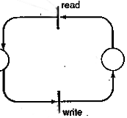
(C) Petri Nets
Q: modify it so that buffer is 3.
3
Figure. 4.21
An integrated Petri net describing
a producer-consumer system.
Notes:
Modification of Petri net is much easier than that for Finite State Machines. This slide illustrate the point.
Here we assume read or write only one message at a time, then there are 4 missing links that should be added to this slide to complete the Petri Nets. Can you figure them out?

Slide 76
(C) Petri Nets
PN limitations
  PN tokens are anonymous (no values), which couldn’t specify special firing conditions
Channel 1
(for correct
message)
Channel 2
(for incorrect
message)
  Needs techniques to prevent starvation.
  Generally, it is not possible to specify a selection policy between different enable transitions.
  __Timing____ issues are not well modeled
Notes:
Even though PNs model certain aspects of systems quite well, their use in applications has revealed some weaknesses when they are used for software specification. First, they are like FSMs, a control-oriented model. Tokens typically represent the flow of control in the execution of several actions. The tokens, however, are anonymous.
For example, the presence of a token in a place may denote only the presence of a message in a buffer, not what the message says. This simplicity may be useful. Often, for example, when we are interested in analyzing the flow of messages within a communication network-the important issue is whether a message that has been produced somewhere will be delivered somewhere else. In such cases, the actual content of the message may be an irrelevant detail.
Another drawback of PNs is the fact that, in the general case, it is not possible to specify a selection policy between different transitions that are enabled.
Timing issues are another critical aspect of some systems. Unfortunately, most models of computer systems, including PNs, do not take time into account explicitly.

Slide 77
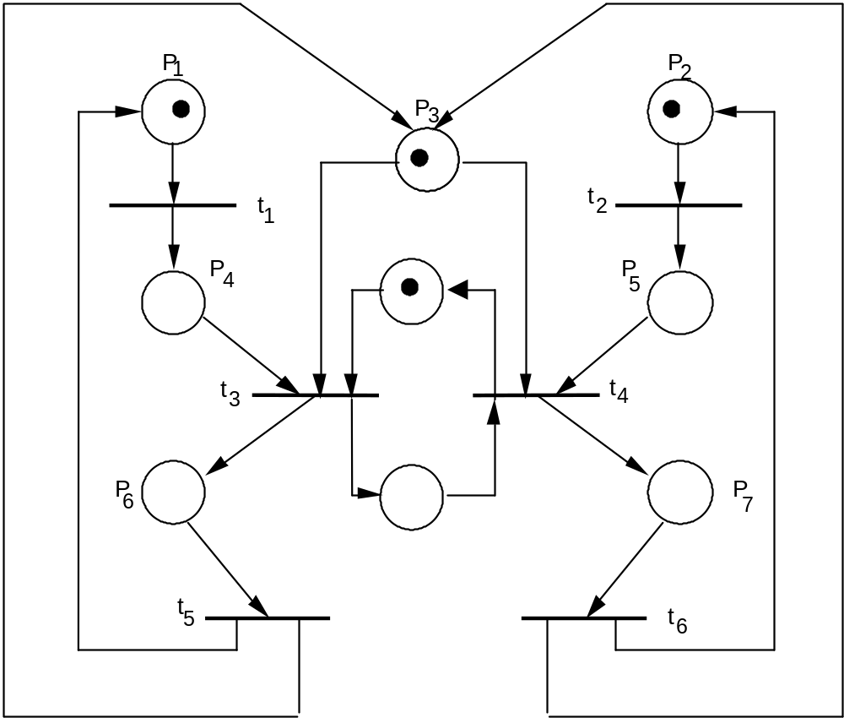
(C) Petri Nets
⇒
Notes:
For instance, going back to the PN of the figure shown in the left, we already noticed the possibility of the firing sequence <t1, t3, t5> repeating indefinitely, starving the activity consisting of <t2, t4, t6>. To avoid starvation in this case, we could enforce an alternation policy by modifying the net slightly as shown in the right figure. This modified net prevents t3 from firing a second time before t4 has fired once.
This example also shows a lack of depth in modeling and analysis when timing issues are not considered. Let us assume that the actions occur as soon as they are enabled. Let us also assume that the firing of a transition occurs when the corresponding actions modeled by the transition ends. If the actions modeled by t1, t3, and t5 take 1 second each to be completed, and the action modeled by t2 takes 5 seconds, then, clearly, the firing sequence <t1, t2, t3, t5, t4> is not feasible, contrary to what is suggested by the net. In fact, suppose that at time 0 both t1 and t2 start. At time 1, t3 can start, but t2 is not completed. Thus, the firing of t2 cannot occur before the firing of t3.

Slide 78
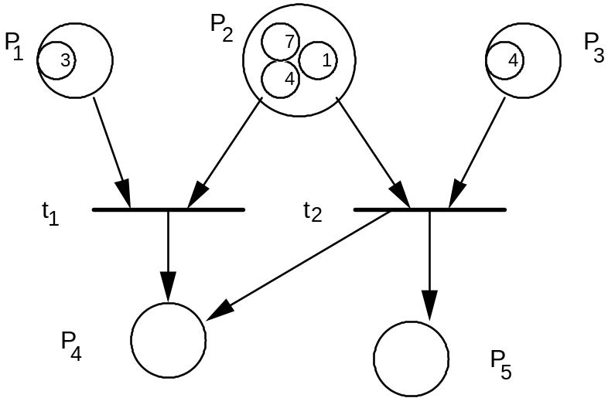
(C) Petri Nets
PN extensions
  assign values to tokens: “Colored-Petri Net”
Figure 4.22 A Petri net whose tokens carry values. The predicate P₂ > P₁ and the Function
P₄ := P₂ + P₁ are associated with t₁; the predicate P₃ = P₂ and the functions
P₄ := P₃ – P₂ and P₅ := P₂ + P₃ are associated with t₂
  augment PN by using predicates for each transition.
    E.g. assign _priority_ to specify scheduling policies
Notes:
Luckily, the flexibility of the Petri net model has allowed it to be extended in several directions while maintaining its original features. Let us review some fairly standard modifications of PNs that have proved useful in several circumstances. For simplicity, we will assume the default case, where the weight is 1 for all elements of the flow relation.
The first extension is assigning values to tokens. Tokens can be modified to carry a value of an appropriate type: an integer, an array of bytes, or even a full environment consisting of several variables and associated values. Transitions are also modified to have associated predicates and functions. The firing rule for transitions is now based on the values, as well as the presence, of tokens. A transition with k input places and h output places is enabled if there exists a k-tuple of tokens-one for each input place-such that the predicate associated with the transition is satisfied by the values of the tokens of the tuple. These tokens are together called a ready tuple.
The second extension is specifying scheduling policies. When the pure nondeterminism of the Petri net model is not adequate: we face the problem of specifying a policy for selecting a transition to fire among all the enabled transitions. A fairly simple way of doing this is to attach priorities to transitions. Then we modify the firing rule in the following way: If, in some state, several transitions are enabled, only the ones with maximum priority are actually allowed to fire. According to our definition, priorities are static. If tokens carry a value, however, we could also define dynamic priorities whose values depend on the values of the tokens of the input places of the transitions.

Slide 79
(C) Petri Nets
  timed Petri nets in which a pair <t_{min},t_{max}> is associated with each transition.
p₁
p₂
p₃
t₁
t₂
t_{min} = 1
t_{max} = 4
priority = 1 (low)
t_{min} = 2
t_{max} = 3
priority = 3 (high)
=> t₁ cannot fire between 2 ≤ t ≤ 3
    An earlier example
    A more precise spec by choosing Figure 4.23 or Figure 4.24
    (next two slides)
Notes:
The third extension is timed Petri nets. Subtle theoretical problems arise when one introduces time within formal computation models. Such theoretical issues are beyond the scope of this text; accordingly, we just mention that the notion of time has been added to Petri nets in several ways We describe one of the most simple and natural ways of introducing time into PNs by scratching only the surface of this hard problem.

Slide 80
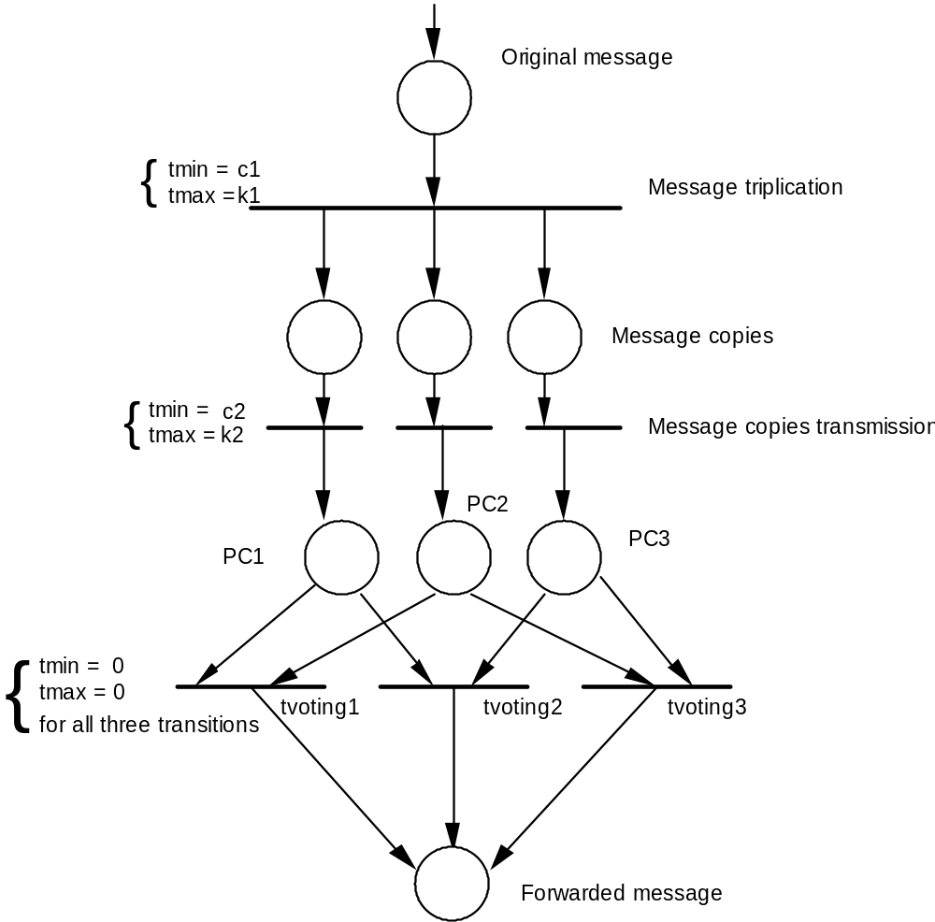
Figure 4.23
Notes:
We have described early about an ambiguous specification in natural language regarding “message triplication”, where we state “the receiver accepts the message on the basis of a two-out-of-three voting policy”. It is ambiguous regarding two different interpretation.
The first interpretation was that the message should be considered received as soon as two identical copies have been received. This interpretation is formalized by the PN of Figure 4.23. With this formulation, as soon as two tokens with identical values are present in P1, P2, or P3, the corresponding transition fires.
A different interpretation of the informal requirements, based on the decision to wait until all three copies have been received before performing the comparison, is formalized by the net of Figure 4.24.

Slide 81
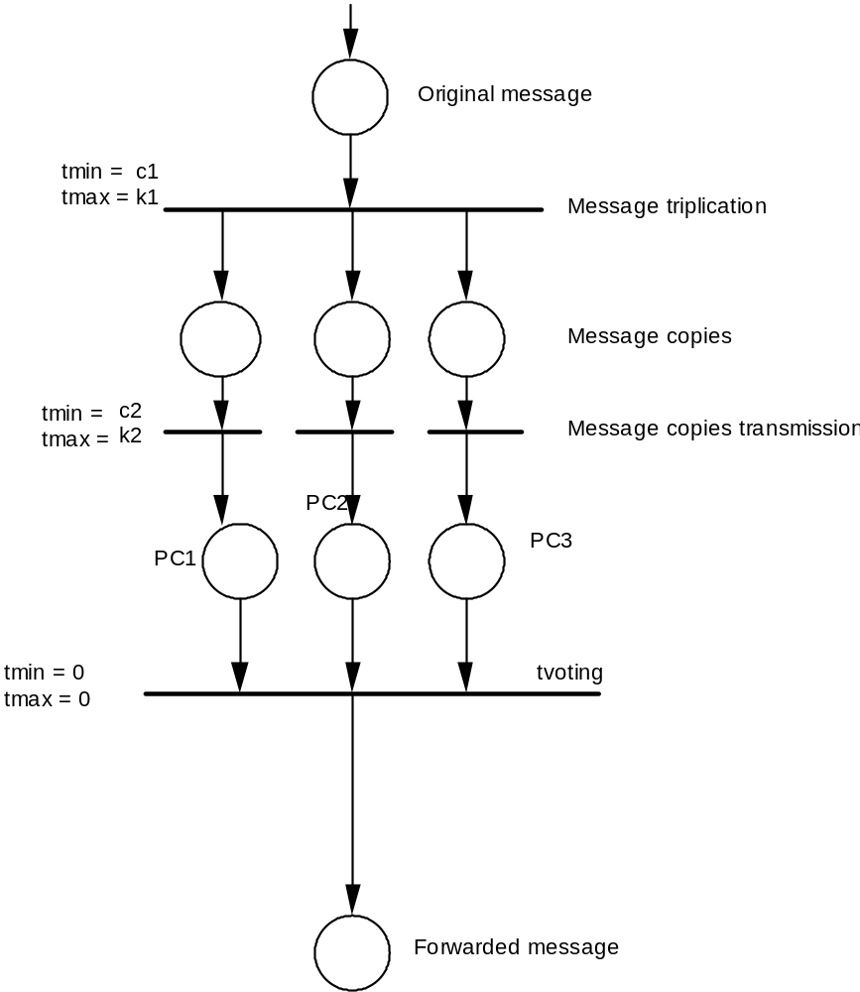
Figure 4.24
Notes:
This example of receiving triplicate messages shows that the use of a formal model allows us to attach a precise meaning to a system specification. Furthermore, the formal model may be the basis of a rigorous analysis.
For instance, if we are interested in determining the maximum time that may be spent to deliver an incoming message, we can easily see that it is k1 + k2 in both cases. If, however, we assume that transmission of the copies through the three channels takes a time that is randomly distributed within c2 and k2, we find that the probability of receiving the message in place “Forwarded Message” within time t (with c1 + c2 <= t <= k1 + k2) is higher in the case of Figure 4.23 than in the case of Figure 4.24.

Slide 82
Descriptive Specifications
  Describe the desired _property_ of a system rather than the desired _behavior__
(A) Entity-Relationship Diagrams
  ___semi-formal____
(B) Logic Specifications
  __formal__________
(C) Algebraic Specifications (skip)
  __formal___________
Notes:
As we stated in early slides, descriptive specifications try to describe the desired properties of a system rather than its desired behavior. In this part, we start a short review of descriptive specification notations with a semiformal and widely used model.
Then we move to completely formal notations. We illustrate different notations that can be used to specify systems at different stages of the development process. Some notations are suitable for use at the requirements level. Others are suitable for specifying the semantics of module interfaces. Still others are suitable for specifying individual program fragments. All of the notations, however, share the same flavor of the descriptive style.
A natural way of providing precise descriptive specifications is through the use of mathematical formulas. Unlike natural language, mathematical formulas have a precise syntax and semantics. Furthermore, they can be managed by automated tools as well as formal operational models.

Slide 83
(A) Entity-Relationship (ER) Diagrams
Basic elements
  (1) entities - collections of items that share common properties.
  (2) relations - connections between two entities.
  (3) attributes - characteristics within each entity.
  A relation R on two entities A, B is a set of pairs <a,b>,
  where __a belongs to A, b belongs to B iff A R B _________________________
Notes:
The ER model was motivated by the need for a conceptual model of data suitable for specifying user views and logical requirements in information systems and, more generally, in applications that are centered around large collections of interrelated data.
The model is based on three primitive concepts: entities, relations, and attributes. The model has an associated graphical language, which is particularly easy to understand; the descriptions given in the graphical language are called ER diagrams.

Slide 84
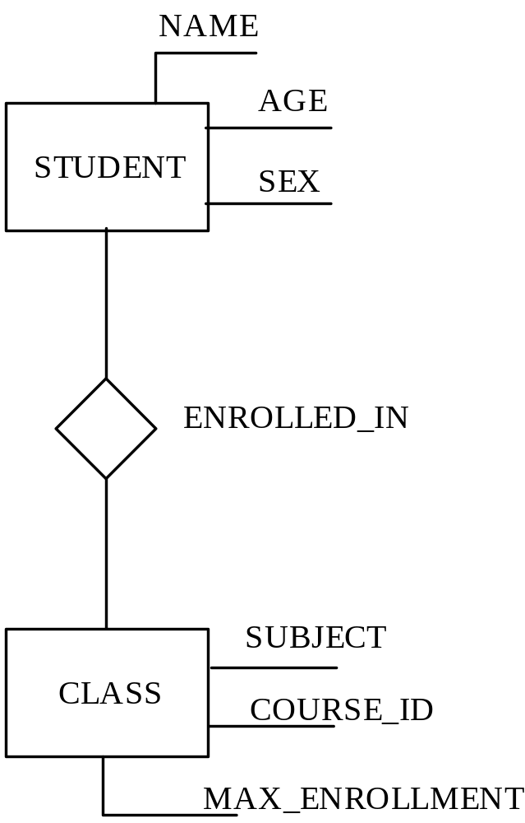
(A) Entity-Relationship (ER) Diagrams
Figure 4.25 An ER diagram describing
a relationship between students and
classes
____4_____kinds of constraints on the relationship R
Notes:
Figure 4.25 shows a simple example of an ER diagram .that describes the entities STUDENT and CLASS, with the relationship ENROLLED_IN, which may hold between a STUDENT and a CLASS. An entity-represented by a box-stands for a collection of items that share common properties; the concept is thus similar to that of a type in programming languages.
The properties of an entity are its attributes and the relations in which it participates. Attributes are listed next to the entity, and relations are represented as diamond-shaped boxes. In our example, STUDENT is a collection of individuals; NAME, AGE, and SEX are attributes of STUDENT; and every student is characterized by a triple of values representing the student's name, age, and sex.
A relation on two entities such as STUDENT and CLASS is a set of pairs <a, b>, where a is an element of STUDENT and b is an element of CLASS. The relation shown in Figure 4.24 could represent the fact that student a is enrolled in class b.

Slide 85
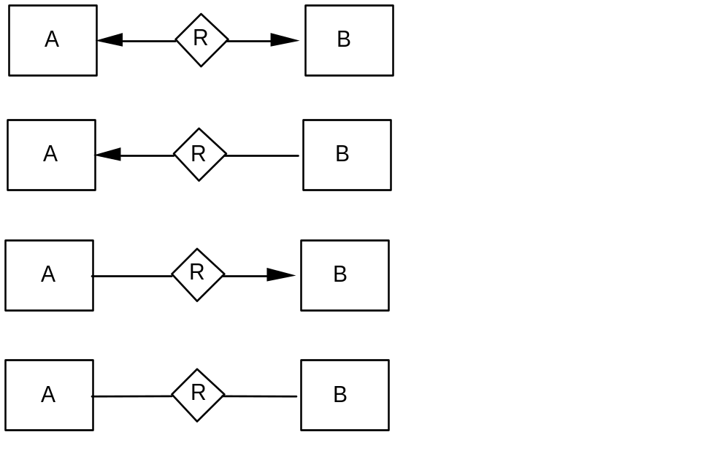
(A) Entity-Relationship (ER) Diagrams
Relations can be partial
They can be annotated to define
  one to one
  one to many
  many to one
  many to many
Notes:
The annotations in this figure describe simple constraints: on the relationship. In practice, however, when we specify requirements, we would like to be able to state more general and complex kinds of constraints on our data that might characterize some important properties of the world we are modeling.
Unfortunately, the power of the ER language is rather limited, and more complex concepts must be expressed separately by using a different notation. For example, there is no way to specify graphically that a class can exist only if the number of enrolled students is greater than five and that the number cannot exceed the value MAX ENROLLMENT that is an attribute of each class.
If we want, this constraint can be stated as a comment in natural language, associated with the diagram as further documentation.

Slide 86
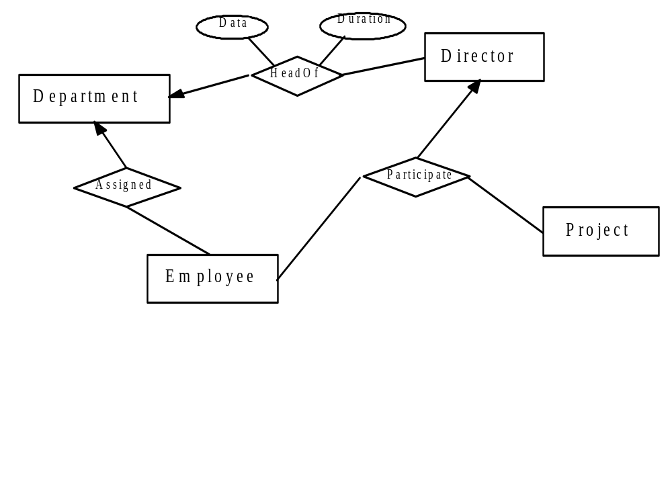
Non Binary Relations
4 entities
3 relations
ER diagram is often a complement to________
to describe conceptual data models
Notes:
A relation can connect more than two entities. This figure shows a non binary relation example.
ER diagrams are used to complement DFDs.

Slide 87
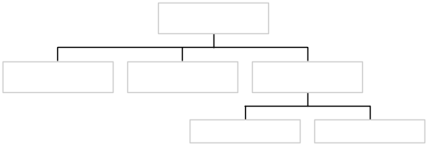
(A) Entity-Relationship (ER) Diagrams
Summary about ER diagrams:
  (1) ER diagrams are a semiformal spec notation.
  (2) Due to the lack of expressive power in ER diagrams, we need to add properties as informal comments.
    e.g. combined with “logic specification” to be shown later
  (3) ER diagrams are a descriptive notation because they state the entities and their properties.
    Widely used in database applications for a unified view of data.
    A key model in knowledge graph research nowadays.
      Tabular
      Hierarchical
      ER – P. Chen [1976]
attribute <key>
tuples
Notes:
You may have noticed that ER diagrams are similar to a simplified form of class diagrams. In fact, class diagrams have been defined as an evolution of ER diagrams wherein data entities are modeled along with their operations in an object-oriented style. In a conventional style, in which functions and data are defined separately. In an object-oriented style, the two aspects are clustered together in classes.
ER diagrams are still widely used in practice especially in data-oriented applications. Since they are graphical, they are rather understandable even by nonspecialists. It is also claimed that they are effective for the assessment of requirements, since end users may be trained to understand them and thus may verify whether the. description provided by the software engineer models the application's domain adequately in terms of the relevant entities and their relationships.
ER diagrams represent a key model in the popular knowledge graph research nowadays.

Slide 88
(B) Logic Specifications
What is logic spec?
  Based on first-order theory (FOT) - an expression (formula) involving symbols in traditional mathematics.
  Logical connectives - and, or, not, implies, and ≡ (logical equivalence) - are used.
  the type of result must be Boolean.
  use quantifiers (e.g., “exists” ∃, “for all” ∀). ⇒ quick examples
a variable that occurs in a formula is ____free____ if it is not quantified.
a quantified variable is ___bound____.
if all variables in a formula are quantified, the formula is ___closed____.
a closed formula is always either true or false.
How to obtain?
the closure of a formula is obtained by quantifying all of its free variables
with the _”for all”, “exist”__ quantifier.
Notes:
A formula of a first-order theory (FOT) is an expression involving variables, numeric constants, functions, predicates, and parentheses, as in traditional arithmetic. The usual logical connectives-and, or, not, implies, and a (which denotes logical equivalence) are also used. The type of the result of a first-order-theory formula must be Boolean. As opposed to the Boolean-valued formulas of many programming languages, however, FOT formulas may also use quantifiers-that is, the symbols exists and for all that can be applied to variables.
A variable that occurs in a formula is said to be free in that formula if it is not quantified; a variable that is not free is said to be bound. If all variables in a formula are quantified, the formula is said to be closed. A closed formula is always either true or false. The closure of a formula is obtained by quantifying all of its free variables with the for all quantifier. If a formula is true for all values of its free variables, so is its closure.

Slide 89
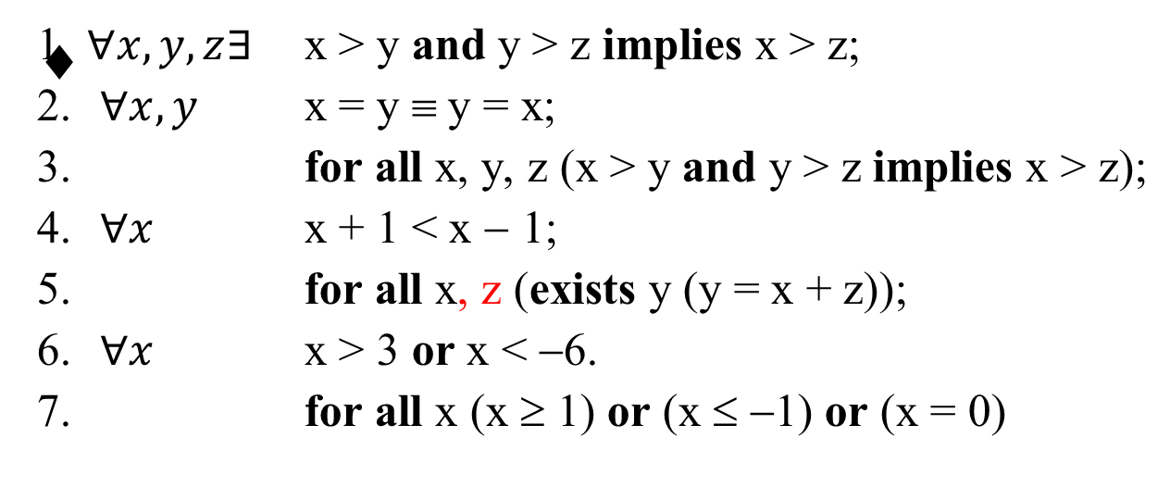
(B) Logic Specifications
evaluation
T
T
T
F
T
F
7: true or false?
True if x is __integer__; false if x is __real number__
Combine with ER diagrams: See the Figure in next page.
Notes:
In some cases, the truth of a formula depends on the domain chosen for its variables.
For instance, the formula 7 is true if x is an integer; it is false if x is a real number. In this book, however, we will deal with variables whose domains should be understood without ambiguity. In particular, numeric variables will be assumed to be integers, unless stated otherwise.

Slide 90
“A class can exist only if the number of enrolled students is greater than five, and the number cannot exceed the value MAX_ENROLLMENT”
∀ b in CLASS
5 ≤ cardinality { a | <a,b> in ENROLLED_IN } ≤ b.MAX_ENROLLMENT
a: student b: class
Notes:
Earlier, we observed that ER diagrams can be classified as a semiformal descriptive notation. We can illustrate this property by showing that ER diagrams may be easily restated in terms of logic; moreover, logic provides a formal notation to express the constraints that are not expressible in terms of ER diagrams. For example, in the discussion relating to Figure 4.25, the constraint that "a class can exist only if the number of enrolled students is greater than five, and the number cannot exceed the value MAX_ENROLLMENT" can be stated as:
for all a in CLASS
5 <= cardinality {a l < a, b > in ENROLLED_IN) <= b.MAX_ENROLLMENT
where we use the dot notation to denote the value of an entity's attribute. Also, the function cardinality has been introduced to indicate the number of elements in a set.

Slide 91
(B) Logic Specifications
Four Applications of Logic Specifications
  Specifying complete programs
    Input-Output Assertations
  Specifying program fragments
  Specifying classes
  Specifying non-terminating behaviors
Notes:
Four Applications of Logic Specifications
Specifying complete programs
Specifying program fragments
Specifying classes
Specifying non-terminating behaviors

Slide 92
(B) Logic Specifications
Specifying complete programs: input-output assertions
  Definition:
  Let P be a sequential program, let <i₁,i₂, …,i_{n}> denote the sequence of P’s input values and <o₁,o₂, …,o_{m}> the sequence of P’s output values
  A property, or requirement, for P is expressed as
  {Pre (i₁,i₂,…,i_{n})}
  P (_program___)
  {Post(o₁,o₂,…,o_{m},i₁,i₂,…,i_{n})}
where Pre (i₁,i₂,…,i_{n}) denotes a FOT formula having i₁,i₂,…,i_{n} as free variables and Post(o₁,o₂,…,o_{m},i₁,i₂,…,i_{n}) denotes a FOT formula having o₁,o₂,…,o_{m} and, possibly, i₁,i₂,…,i_{n} as free variables.
Pre - __precondition__ of P
Post - __postcondition__ of P
Note: even simple spec problems may require many details and may be hard to understand
Notes:
We start with the simplest use of mathematical formulas to express software properties. Let P be a sequential program. Let <i1, i2 , …. , in> denote the sequence of P's input values and <o1, o2, ….., om> the sequence of P's output values.
More precisely, assume that P reads all in, put values from, and writes all output values to sequential files;<i1, i2, …., in> is the sequence of values stored in the input file in the order in which P reads them, and <o1, o2, . . . , om> is the sequence in which P writes its output.

Slide 93
Logic Specifications for Complete Programs
Input-output assertions (assuming integers in the following)
  1. { exists z ( i₁ = z × i₂ ) }
    P
    {o₁ = i₁ / i₂ }
  2. { i₁ > i₂ }
    P
    { i₁ = i₂ × o₁ + o₂ and o₂ ≥ 0 and o₂ < i₂ }
  3. {true}
    P
    { (o = i₁ or o = i₂) and o ≥ i₁ and o ≥ i₂ }
o₁: quotient; o₂: remainder
no constraint on input (always hold for all input)
Notes:
Example 1
This states that, if the input value i1 is a multiple of the input value i2, then the output must be the result of the division i1/ i2.
Example 2
This requirement is stronger in the sense that it imposes fewer constraints on the input values and more constraints on the output values. A precondition of {true} does not place any constraint' on input values; it always holds, regardless of the input values, implying that the program will achieve its result for all input values.
Example 3
It requires that P produce the greater of i1 and i2.

Slide 94
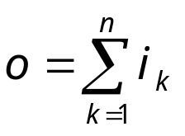
Logic Specifications for Complete Programs
  4. { i₁ > 0 and i₂ > 0 }
  P
  { (exists z₁, z₂ (i₁ = o × z₁ and i₂ = o × z₂))
  and not
  (exists h (exists z₁, z₂ (i₁ = h × z₁ and i₂ = h × z₂) and h > o))}
  5. { n > 0 }
  P
  { }
  6. { n > 0 }
  P
  { for all i (1 ≤ i ≤ n) implies (o_{i} = i_{n-i+1} ) }
Notes:
Example 4
It requires that P compute a specific output as a function of i1 and i2. What is it?
Example 5
Assuming that n is a positive value denoting the length of the input sequence, the specification requires that P compute the sum of the sequence.
Example 6
Finally, the specification requires that P produce the reverse of its input sequence, assuming that the input sequence is not empty.

Slide 95
Logic Specifications for Complete Programs
Example: Specifying input as a sequence of words separated by a blank and bracketed by a pair of delimiters ‘#’
input_word(m,n) ≡ (for all i (m ≤ i ≤ n) implies alphabetic(c_{i}))
input_text(m,n) ≡
( i_{m} = ‘#’ and i_{n} = ‘#’ and
( exists k (for all j (1≤ j ≤ k) implies
( exists h_{j}, m_{j} (input_word(m_{j},m_{j} + h_{j}) and
m₁ = m + 1 and m_{k} + h_{k} + 1 = n and
(1 ≤ j < k) implies (m_{j+1} = m_{j} + h_{j} + 2 and
i_{mj+hj+1} ^{= ’ ’} ) ) ) ) ) )
Notes:
For this example, we could introduce the predicate input_word (m, n) to state that the sequence of characters in the input stream, from the mth through the nth positions, is a word. This notion is formalized by the formula input_word (m, n) where ci represents the ith input character and alphabetic (c) means that c is an alphabetic character. (The formalization of this predicate is a trivial exercise.)
Now we can use the predicate input_word as a compact and understandable abbreviation whenever it is needed. In particular, we can define the predicate input_text (m, n) to state that the sequence of elements of the input file from the mth through the nth positions is 'a piece of text’; that is, a sequence of words separated by a blank and bracketed by a pair of symbols, “#”.
Once this definition is stated, one can go on to define suitable predicates for the output file and, eventually, an overall relation between input and output files based on the previous definitions.

Slide 96
Logic Specifications for Complete Programs
Example: Specifying input as a sequence of words separated by a blank and bracketed by a pair of delimiters ‘#’
input_word(m,n) ≡ (for all i (m ≤ i ≤ n) implies alphabetic(c_{i}))
input_text(m,n) ≡
( i_{m} = ‘#’ and i_{n} = ‘#’ and
( exists k (for all j (1≤ j ≤ k) implies
( exists h_{j}, m_{j} (input_word(m_{j},m_{j} + h_{j}) and
m₁ = m + 1 and m_{k} + h_{k} + 1 = n and
(1 ≤ j < k) implies (m_{j+1} = m_{j} + h_{j} + 2 and
i_{mj+hj+1} ^{= ’ ’} ) ) ) ) ) )
c_{i} is an alphabetic character
#: delimiter
k: no. of words
m_{j} : starting position of j^{th} word
h_{j} : [length of j^{th} word] - 1
⇒ m_{j} + h_{j} : ending position of j^{th} word
last word ends at position m_{k} + h_{k}; adding one gets to n
m₁: first word starts from position m + 1
j+1th word starts from the ending position of j^{th} word plus 2 (1 for space charactor at position m_{j} + h_{j} + 1)
A space at position
m_{j} + h_{j} + 1
Notes:
For this example, we could introduce the predicate input_word (m, n) to state that the sequence of characters in the input stream, from the mth through the nth positions, is a word. This notion is formalized by the formula input_word (m, n) where ci represents the ith input character and alphabetic (c) means that c is an alphabetic character. (The formalization of this predicate is a trivial exercise.)
Now we can use the predicate input_word as a compact and understandable abbreviation whenever it is needed. In particular, we can define the predicate input_text (m, n) to state that the sequence of elements of the input file from the mth through the nth positions is 'a piece of text’; that is, a sequence of words separated by a blank and bracketed by a pair of symbols, “#”.
Once this definition is stated, one can go on to define suitable predicates for the output file and, eventually, an overall relation between input and output files based on the previous definitions.

Slide 97
Logic Specifications for Complete Programs
input_text(m,n)
1,2,3,..,5,…,9,11, … 18,19
#we_shall_overcome#
k = __3_
m₁ = _2__ m₂ = _5__ m₃ = _11_
h₁ = _1__ h₂ = _4__ h₃ = _7__
m₁+h₁ = __3_ m₂+h₂ = _9__ m₃+h₃ = _18__
⇒ specifying a complete program quickly become very complicated and tedious
Notes:
The notes are given in the previous slide. Here is a practicing case.

Slide 98
Logic Specifications for Program Fragments
Intermediate assertions: allow expressions in pre- and post-conditions (assertions) to refer to program variables
  7. { n > 0 } – n is a constant value
    procedure search(table: in integer_array; n: in integer; element: in integer; found: out Boolean);
    { found ≡ (exists i (1≤ i ≤ n and table(i) = element)) }
  8. { n > 0 }
    procedure reverse(a: in out integer_array; n: in integer);
    { for all i (1 ≤ i ≤ n) implies (a(i) = old_a(n-i+1)) }
  9. { n > 0 }
    procedure sort(a: in out integer_array; n: in integer);
    { sorted(a, n) },
    sorted(a,n) ≡ (for all i (1 ≤ i < n) implies a(i) ≤ a(i+1))
Notes:
Example 7
Such a generalization is quite straightforward: A1l we need to do is to allow expressions in pre- and post-conditions to refer to program variables as well as to I/O values, For instance, suppose you want to specify a procedure search with input parameters element, table (an array of integers), and n, the number of elements stored in table. The procedure is to check whether element exists in table.
Example 8
Similarly, one could write the following specification for a subprogram that reverses the contents of an array of integer. In this specification, we needed to state a relation between the values of the program variables before and after the execution of the procedure. Thus, we used the auxiliary variable old_a to denote a's value prior to the execution of the procedure.
Example 9
The example is a specification for a sort procedure

Slide 99
Logic Specification for Specifying Classes
Invariant predicates and pre/post conditions for each method
Example of invariant specifying an array IMPL implementing the abstract data type SET
IMPL: array of size length ≥ 1
for all i, j (1 ≤ i ≤ length and 1 ≤ j ≤ length and i ≠ j)
implies IMPL[i] ≠ IMPL[j]
(assure no _____________ are stored)
Notes:
Specifying properties of the state of program execution, rather than just I/O relations, becomes even more important in the case of object-oriented languages when we wish to specify a class. More precisely, specifying such properties becomes important whenever we wish to specify the behavior of objects of the class during their lifetime, from their creation, as operations are applied to them to change their state and to inquire about their state.
In this case, in fact, there is no notion of a computation that we wish to specify with well-defined starting and ending points. Rather, to understand the effect of an operation applied to an object, we need to be able to characterize the current state of the object, which is the result of any previous sequence of operations applied to it.
One way to characterize object states is through an invariant predicate. The invariant defines a property that characterizes the object from its creation, throughout its lifetime. The invariant must be preserved by the operations For example, if an array IMPL of size length is used in a class to implement the abstract data type SET, the invariant might state that no two elements of IMPL are equal.

Slide 100
Logic Specification for Specifying
Non-terminating Behaviors
Example of non-terminating systems?
_______________
Example: producer + consumer + buffer
Invariant specifies that whatever has been produced is the concatenation of what has been taken from the buffer and what is kept in the buffer
input_sequence = append (output_sequence,
contents(CHAR_BUFFER))
Notes:
Consider the producer-consumer system. To specify the desired system behavior, we need to state a predicate based on the sequences of characters that are read and written. These are neither IO nor program variables in the strict sense: There is neither a declaration nor any use of such variables.
We may refer to them, however, as if they were program variables in the same way we did when referring to the values of the same variable at different points in the execution of a sequential program.
Analyzing this property more deeply, however, we realize that even its new formulation cannot be claimed to be an invariant property in a strict sense. In fact, when, say, the consumer is executing the monitor procedure GET, the buffer contents and OUTPUT_SEQUENCE are not even well defined, We do not, however, need such a strong requirement on the invariance of the desired property. For our purposes, it is perfectly satisfactory that the invariant property hold whenever the system is not executing a monitor procedure.

Slide 101
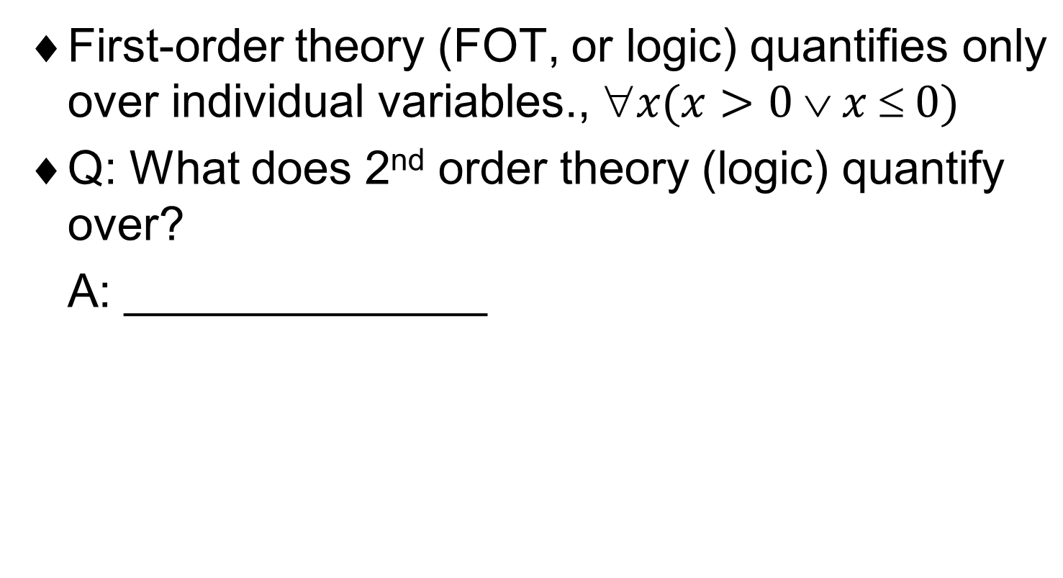
More on Logic Specification
Notes:
denotational semantics: is an approach of formalizing the meanings of programming languages by constructing mathematical objects (called denotations) that describe the meanings of expressions from the languages.

Slide 102
Building and Using Specifications in Practice
  The principle of separation of concerns for spec: Separate functional specs from performance specs, from user interface specs, etc.
  non-functional spec
    the attribute of a system which cannot be provided by
    _________________________________________
  Separation of concerns may result in using different notations for specifying different aspects of a system
    E.g., A document production system with two views –
    DFD: shows data dependencies
    FSM: specifies order of executions
Notes:
The principle of separation of concerns also has some natural implications for specifications.
For instance, whenever possible, functional specifications (i.e., the definition of what the system should do as a consequence of the given input) should be kept separated from performance specifications (the definition of efficiency requirements), from user interface specifications, and so on.

Slide 103
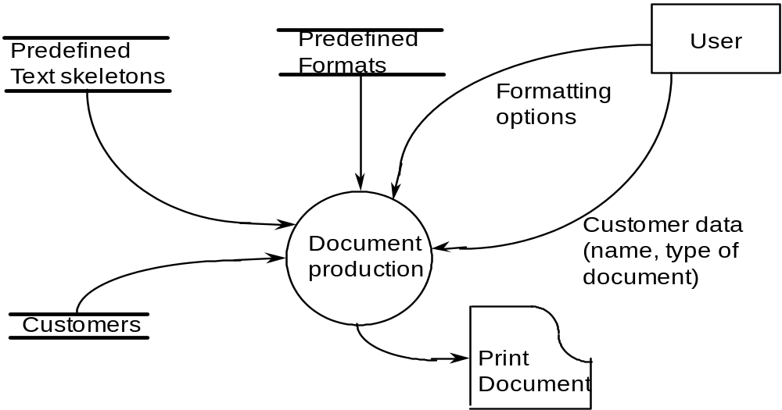
Data Flow View (DFD)
Document Production Example:
Notes:
Sometimes, separation of concerns may eve n result in using different notations for specifying different aspects of a system. For instance, suppose that you wanted to describe the production of a document in an office automation system.
The DFD of the figure describes which sources of information and what kind of data are necessary to produce the document: a library of Predefined Templates (say, contracts of several types in which specific data, such as names, dates, and amounts, are missing); a database of Customers who already have been in touch with the office; the customers themselves; and a set of Predefined Formats to be selected to print the document.

Slide 104
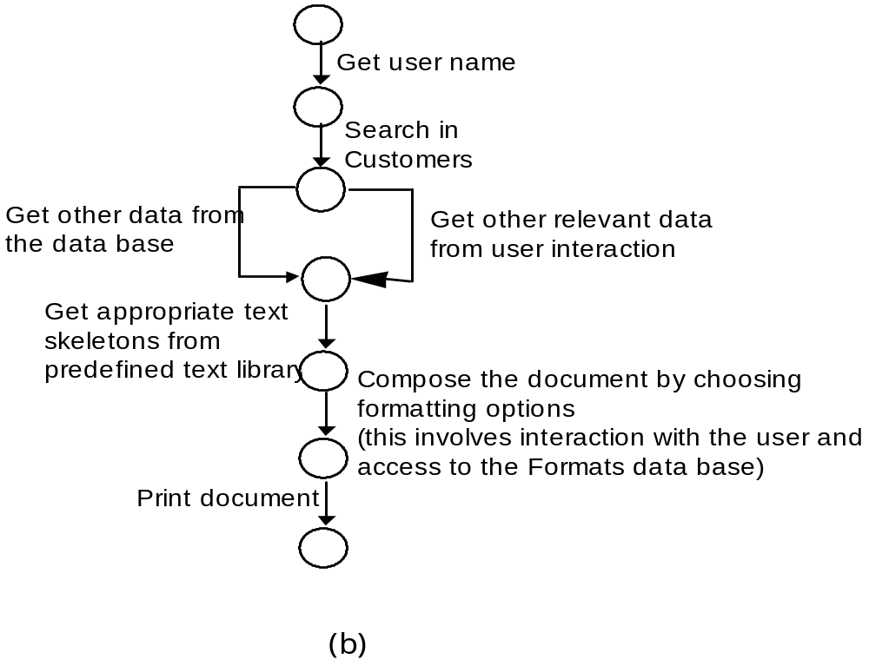
Control Flow View (FSM)
Notes:
The figure in the previous slide, however, does not specify the order of execution of the actions that lead to the composition and printing of the document. This is specified by the FSM of the figure in this slide, which shows that, after having gotten the customer's name, we may get further data-the customer's address, date of birth, etc. either from the Customer database or through more interaction with the customer.
There is intuitive evidence that if the customers record is already in the database; then the edge get other data from the database" is followed. The alternative edge is followed if the customer's record is not in the database.
This, however, is not stated explicitly in the figure. If we wanted to be more precise, we could augment the model by adding suitable labels to the edge to specify the conditions under which it would be followed. As an alternative to an FSM to show the control requirements, we can use UML sequence or collaboration diagrams.

Slide 105
Building and Using Specifications in Practice
  The principle of incrementality is no less important to spec than to implementation. Incrementality should be applied in the construction of spec to the level of rigor and formality.
  A spec document is usually a mixture of informal natural language sentences, semiformal, figures, and fully formalized models.
  Q: Can we hope for one universal spec language?
  A: _______! Spec languages are harder, more complex than programming languages. We cannot expect there will be only one universal spec language!
  The use of ________ is very important
Notes:
We have seen a sample of models and notations that can be used for giving specifications of different systems. Although most of the examples we used were inspired by real software problems, the systems involved were very simple.
In practice, we look at the problem of applying specification techniques to real-life systems. After examining what more is needed for writing and using specifications in practice, we look at a few ways that help tackle the practical problems of dealing with large and complex systems.

Slide 106
Specifications for the End-User
Rigorous specs should be used as common reference for producer and user
They help removing ambiguity, incompleteness, …
Can specs be understood by end-user?
  They can be the starting point for a __________
  They can support some form of animation (e.g., Petri nets)
Notes:
Specifications can be used as a common reference for both the producer and the user of an application. For such a purpose, a specification written in a mathematical formalism is not very useful because most users would not be able to understand such formalisms. Often, the only common language between producer and user is their natural language.
The previous statement is not an argument against the use of formal models. Rather, formal system descriptions could be used to help the producer-user interaction in two different ways. First, once one has used formal models to spot and disambiguate informal and imprecise specifications, it is easy to translate the formalization back into a prose description.
The advantage of this approach is that the resulting description does not suffer from the problems of ambiguity or incompleteness that most likely affects the initial informal description.

Slide 107
Topic 4 Conclusion (1)
Specifications describe
  What the users need from a system (requirements specification)
  The design of a software system (design and architecture specification)
  The features offered by a system (functional specification)
  The performance characteristics of a system (performance specification)
  The external behavior of a module (module interface specification)
  The internal structure of a module (internal structural specification)
Notes:
Depending on its nature, the specification is intended for a particular user: the system designer, the system implementer, the end user. the system manager, etc.
Principles that are similar, though not identical, in content can be used to develop good specifications for these different users.
Specifications can describe various aspects of the software systems, as shown in this slide.

Slide 108
Topic 4 Conclusion (2)
Descriptions are given via suitable notations
  There is no “ideal” notation
They must be modular
They support communication and interaction between designers and users
Notes:
We have stressed that there is no ideal specification style or language, Considering the variety of details that need to be specified for a complex system, the best approach is to use several styles and languages, either for the different objectives that are specific to different stages of the development process, for different parts of the same system, for different views, or even for different users of the specifications.
Such an eclectic approach can encompass a mixture of formal and informal specifications, as well as descriptive and operational ones. UML is an example of this attitude. Obviously, the benefits one may gain in terms of expressiveness are often counterbalanced by the difficulty of providing seamless integration of the different notations.
Again, this explains why it is so difficult to formulate a rigorous, unified semantics for the various diagrams that specify a system in UML.

